Slide 1
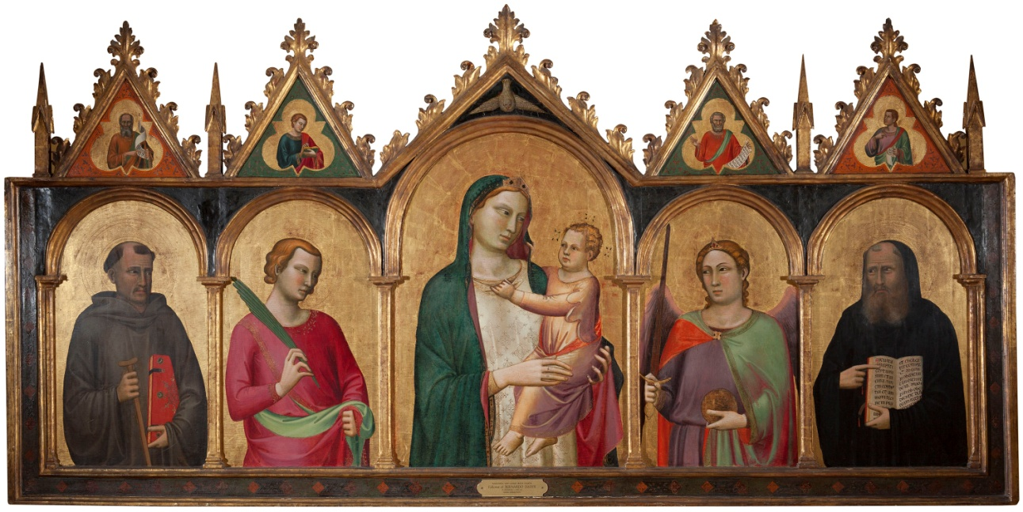
Schedule
4:30 Meet & Greet & Eat!
4:30 Welcome & Introduction
4:40 Slide lecture and discussion
5:30 Gallery tour
6:10 Hands on art making
6:30 Depart through exit by Café NOMA

Slide 2
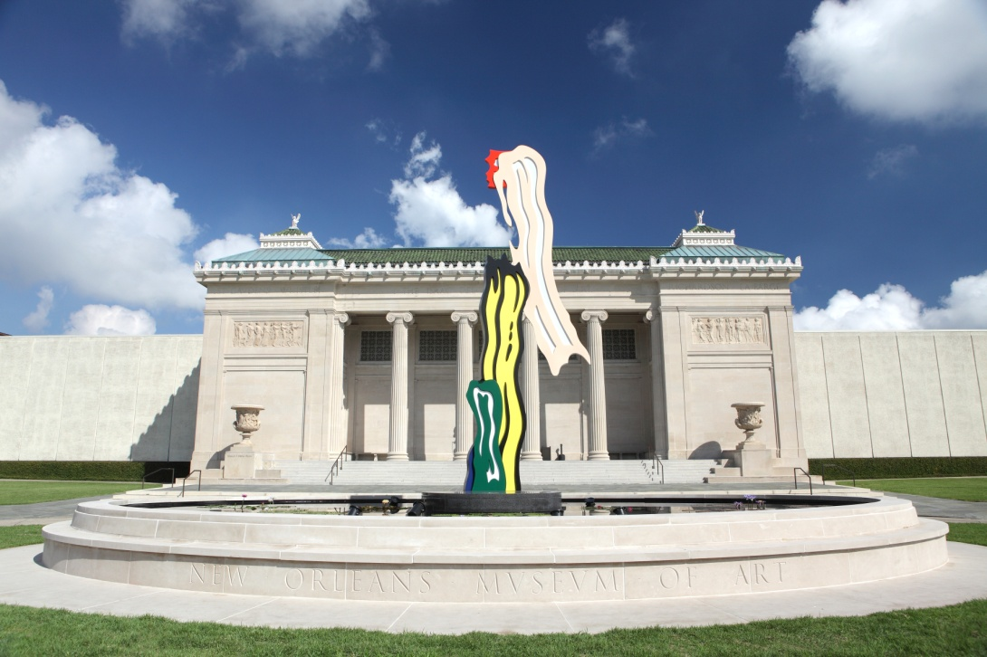
WELCOME TO NOMA!
Opportunities for Educators from the
New Orleans Museum of Art

Slide 3
Available Resources
FREE admission for scheduled school groups
Museum Tours
Collection & Temporary Exhibitions
Bus Reimbursement
Educator Events
Classroom Resources
Public Programs

Slide 4
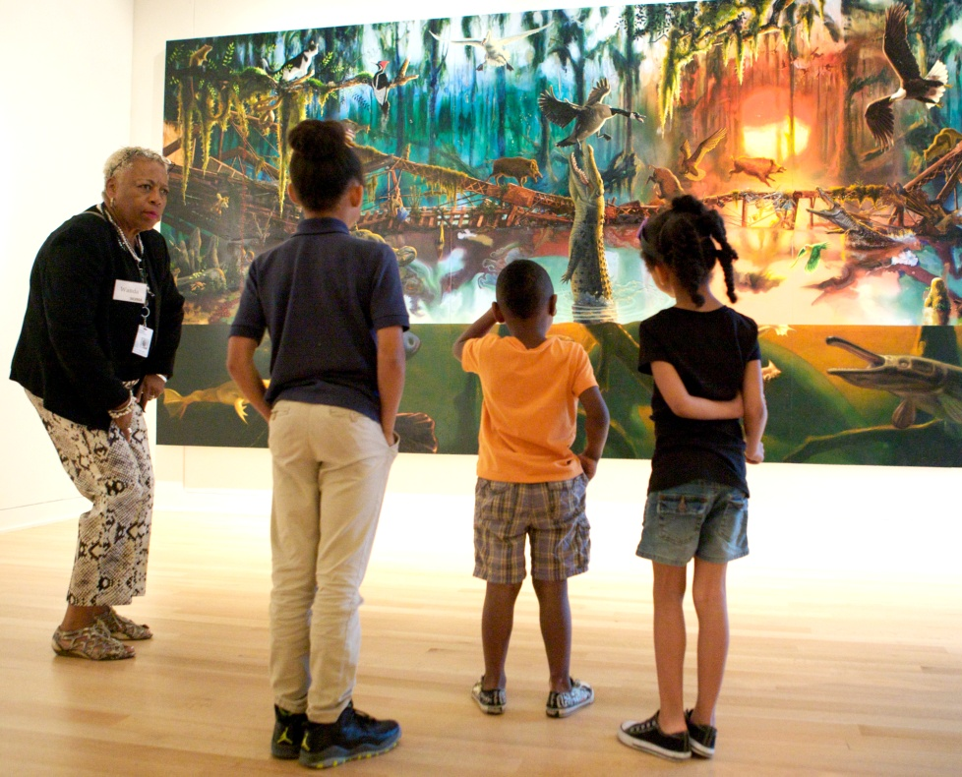
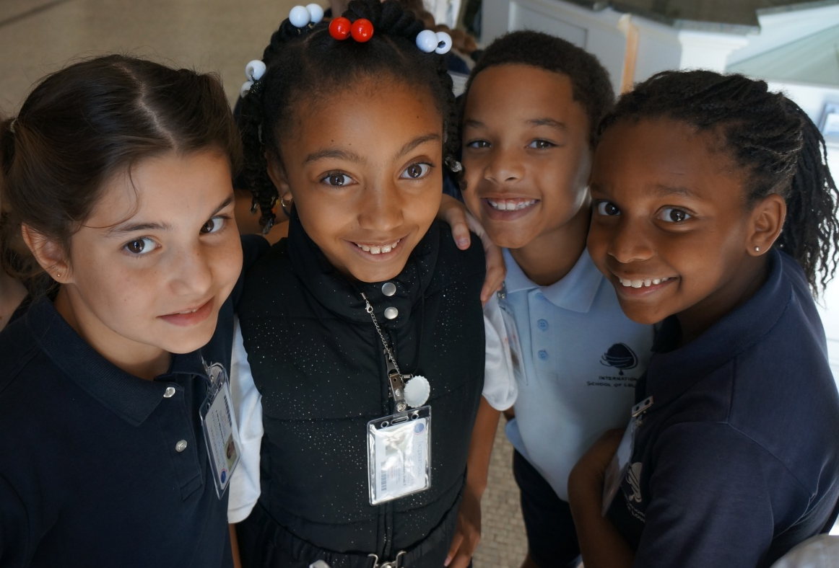
Guided Tours
Teacher-directed or Docent-led
Small Groups
Themed approaches (Visual Art, Social Studies, Language Arts)
Free with appointment

Slide 5
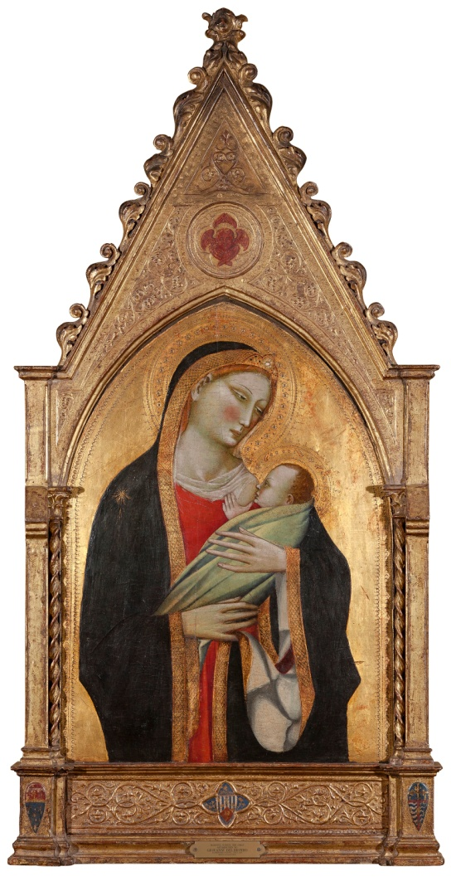
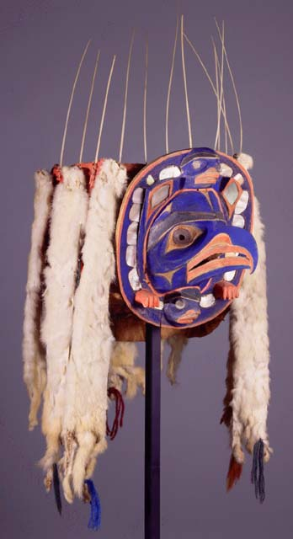
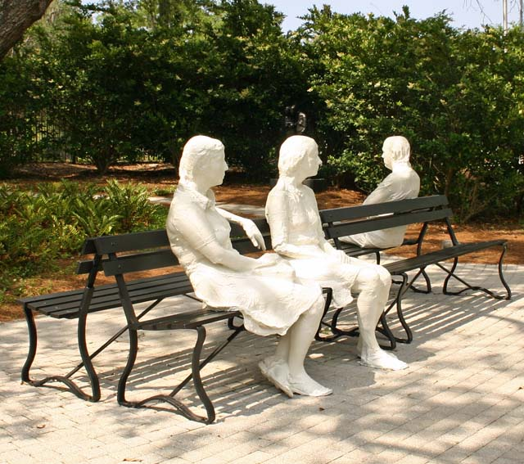
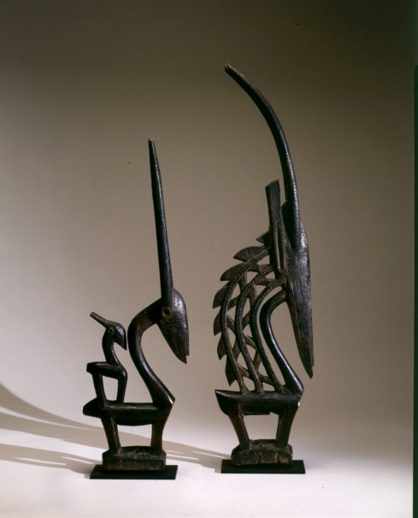
Permanent Collection
Encyclopedic museum
Over 4000 years of art
Cultures from around the world
Besthoff Sculpture Garden
Neoclassical building
Changing installations

Slide 6
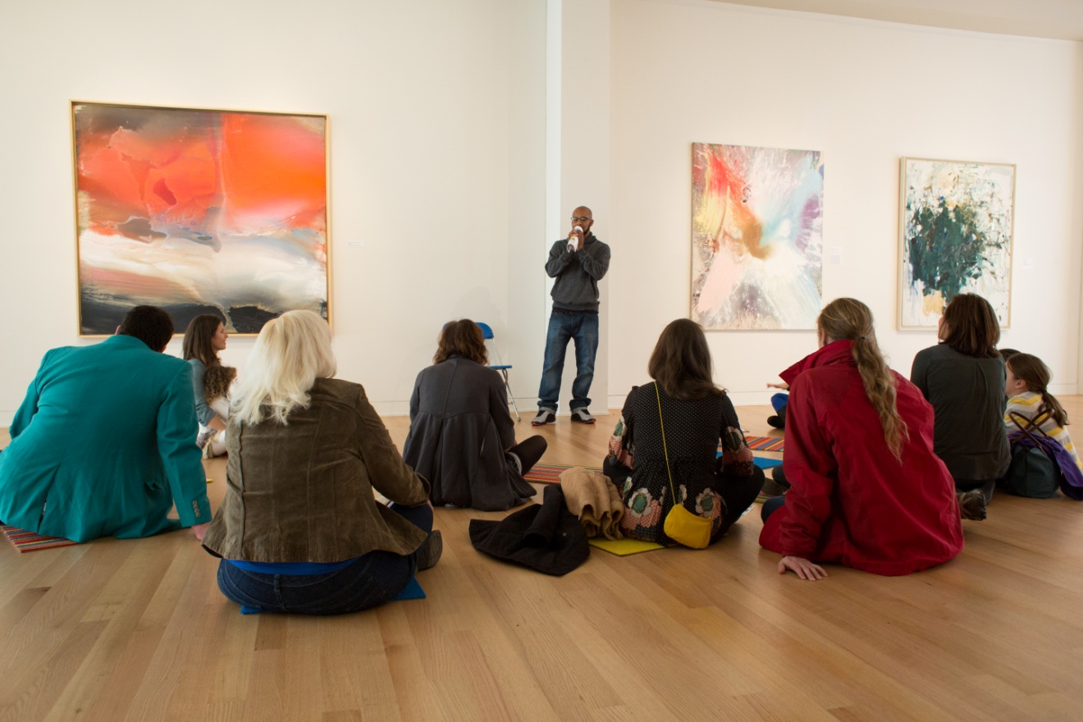
Educator Events
Educator Appreciation Days (3)– May 21, 2016
Professional Development Workshops (4)
Consultations with NOMA Educator

Slide 7
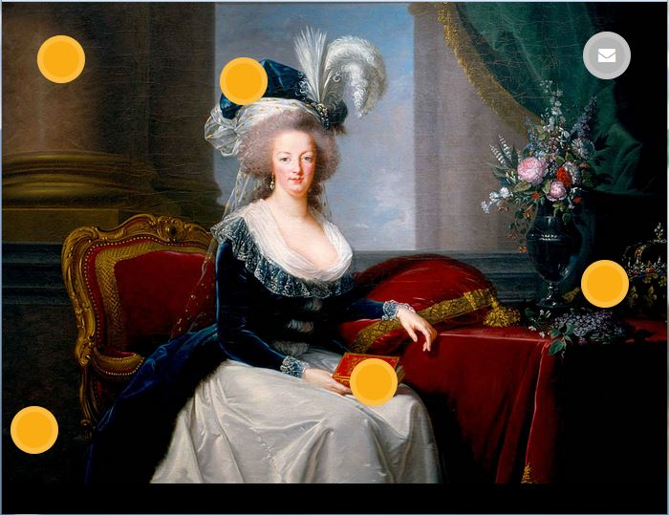
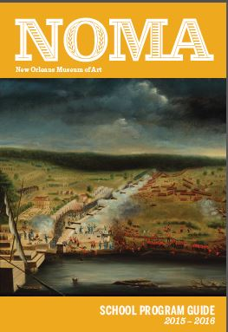
Classroom Resources
NOMA Teaching Posters
Set 1 | Collection Highlights
Set 2 | Art of the Americas
Educator Toolbox
Educator Guides
ARTtabs & NOMA Mobile Guide
www.noma.org/learn

Slide 8
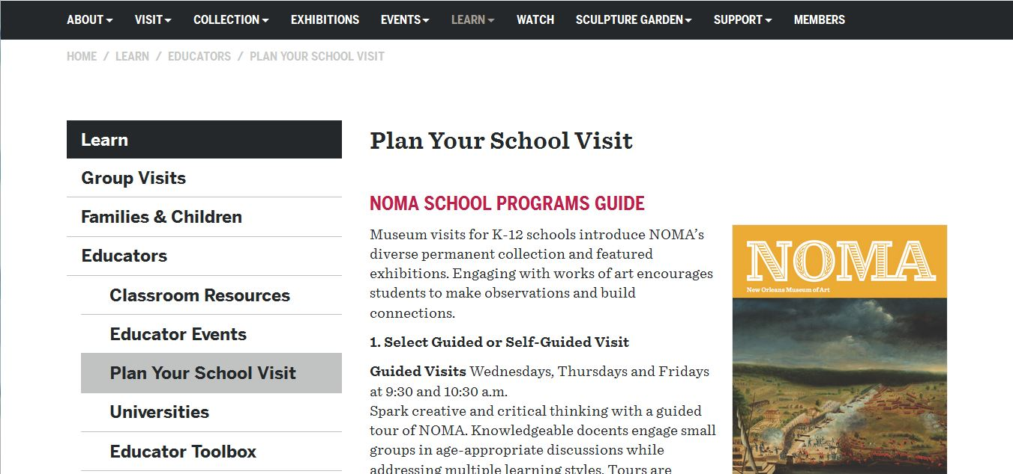
www.noma.org/learn

Slide 9
Educator Toolbox

Slide 10
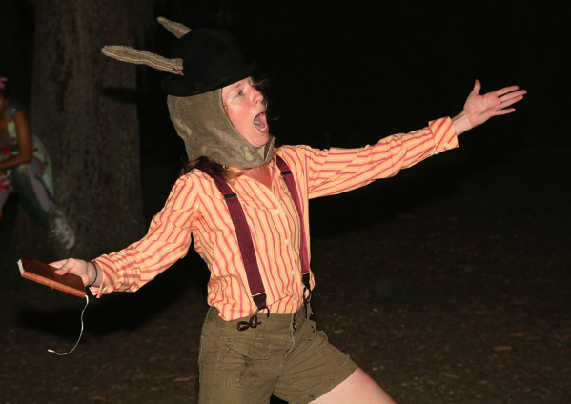
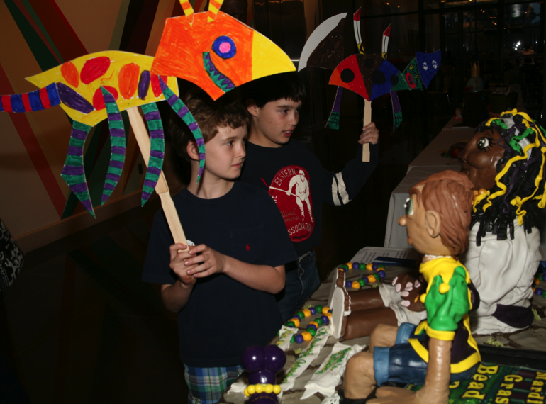
Public Programs
Friday Nights at NOMA
Lectures & Artist Perspectives
Family Days
Festivals
StoryQuest
Studio KIDS!
Theater
Movies

Slide 11
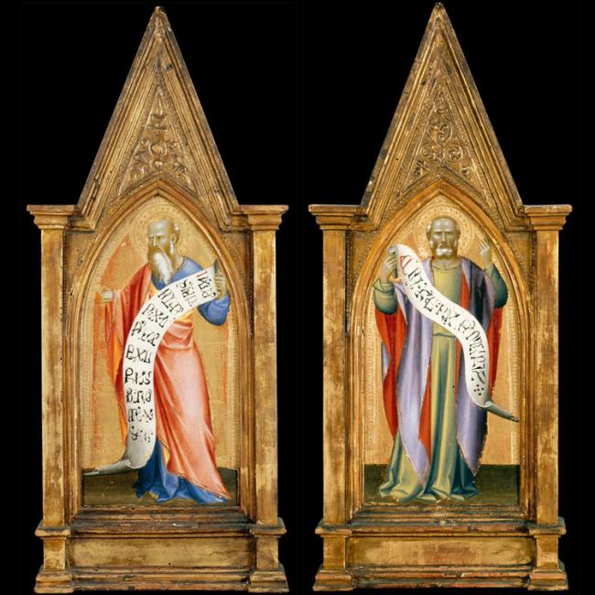
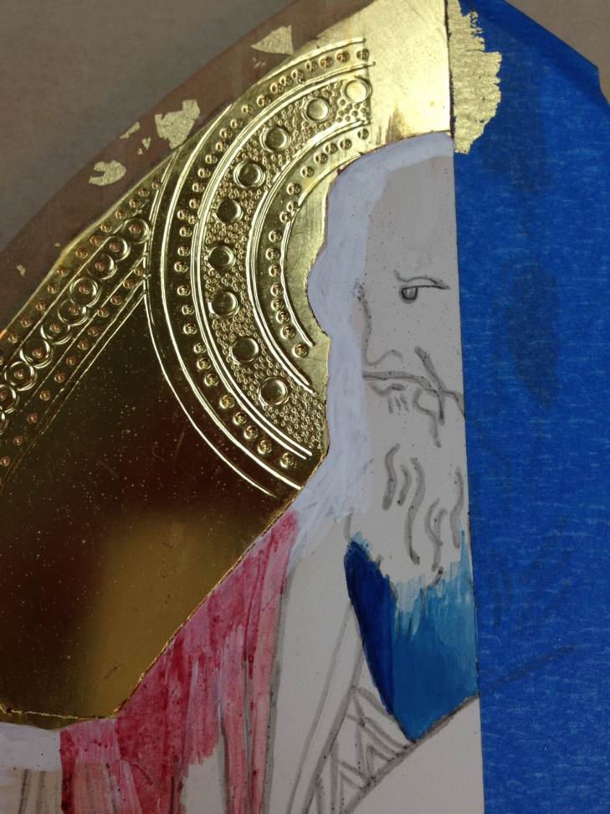
Egg Tempera Painting in the Renaissance: Reconstructing Giovanni del Biondo’s Hebrew Prophet

Slide 12
RENAISSANCE Rebirth
Early Renaissance in Italy (c. 1400-1500)
Flat space, Byzantine influence
Religious scenes with Madonna and Child or Saints as major focus
Egg tempera on wood
Extensive use of gold backgrounds (to be seen in candlelit churches)

Slide 13
High Renaissance in Italy (c. 1500-1520)
Rebirth of classical art and literature
Measured proportions
Balance
Ideal beauty
Religious and mythological scenes
Formal portraits
Underlying anatomical structure: great period of scientific discovery
Use of perspective
Notes:
Masters
Michelangelo Buonarroti
Leonardo de Vinci
Raphael
Titian

Slide 14
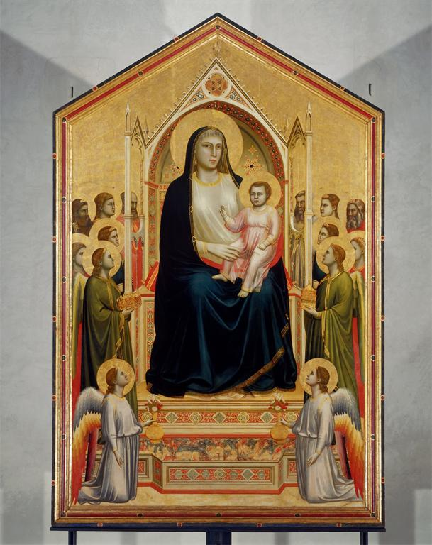
Egg Tempera
Prepared wood panels
Gesso
Red clay (bole)
Gold background
Gilding
Tooling
Egg yolk + water + pigment
Notes:
While egg tempera can be traced back to ancient Greece, it reached its zenith during the early Italian Renaissance and was the medium of choice for artists such as Giotto, Duccio, and Fra Angelico. In Southern Europe, egg tempera was gradually replaced by the "newer" oil paint medium that was popular with artists in the north including Jan van Eyck, Hans Memling, and Rogier van der Weyden. Despite the popularity of oil in the 15th century, egg tempera continued to be used by later Italian Renaissance masters such as Botticelli and Michelangelo. “Rediscovered” in the 19th c. with translation of Cennino Cennini's manuscript, Il Libro dell' Arte . Revival in 20th with artists such as Thomas Hart Benton and Andrew Wyeth.
Yolk: strong, sticky
Gold: malleable,
Giotto, Ognissanti Madonna, c. 1310, tempera on wood, 3.25 x 2.04 m, Galleria degli Uffizi
Masters
Cimabue
Giotto di Bondone (Arena Chapel)
Masaccio
Filippo Brunelleschi (Dome of Florence Cathedral – Duomo)

Slide 15
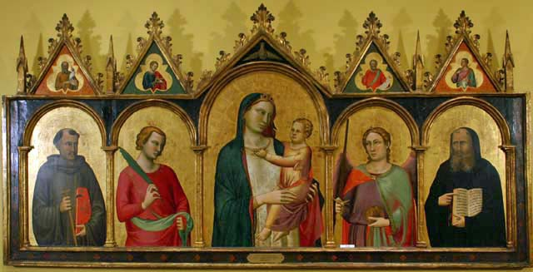
Notes:
Madonna and Child with Saints
Tempera and gold leaf on linden wood, c 1340
Follower of Bernardo Daddi, Italian, Florentine, 1312-1348
Italian Gallery, 1st Floor
The Samuel H. Kress Collection, 61.60

Slide 16
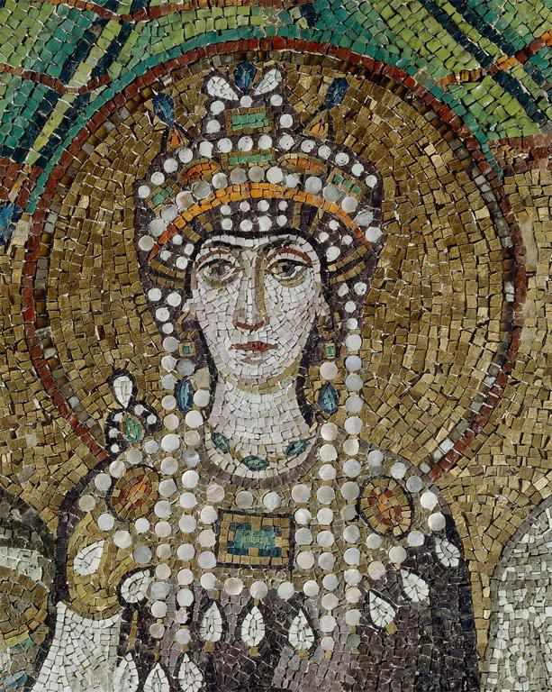

Slide 17
Central Panel Side Panels Pinnacles Predella
PARTS OF AN ALTARPIECE

Slide 18
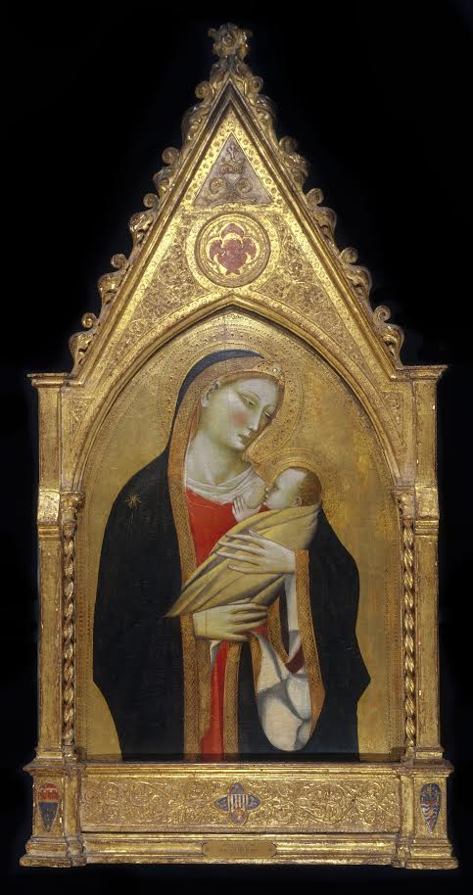
Giovanni del Biondo, Madonna Nursing Her Child
Italian (Florentine)
Egg tempera and gold on a wooden panel ca. 1370
Notes:
Giovanni del Biondo, Madonna Nursing Her Child
Italian (Florentine)
Egg tempera and gold on a wooden panel ca. 1370

Slide 19
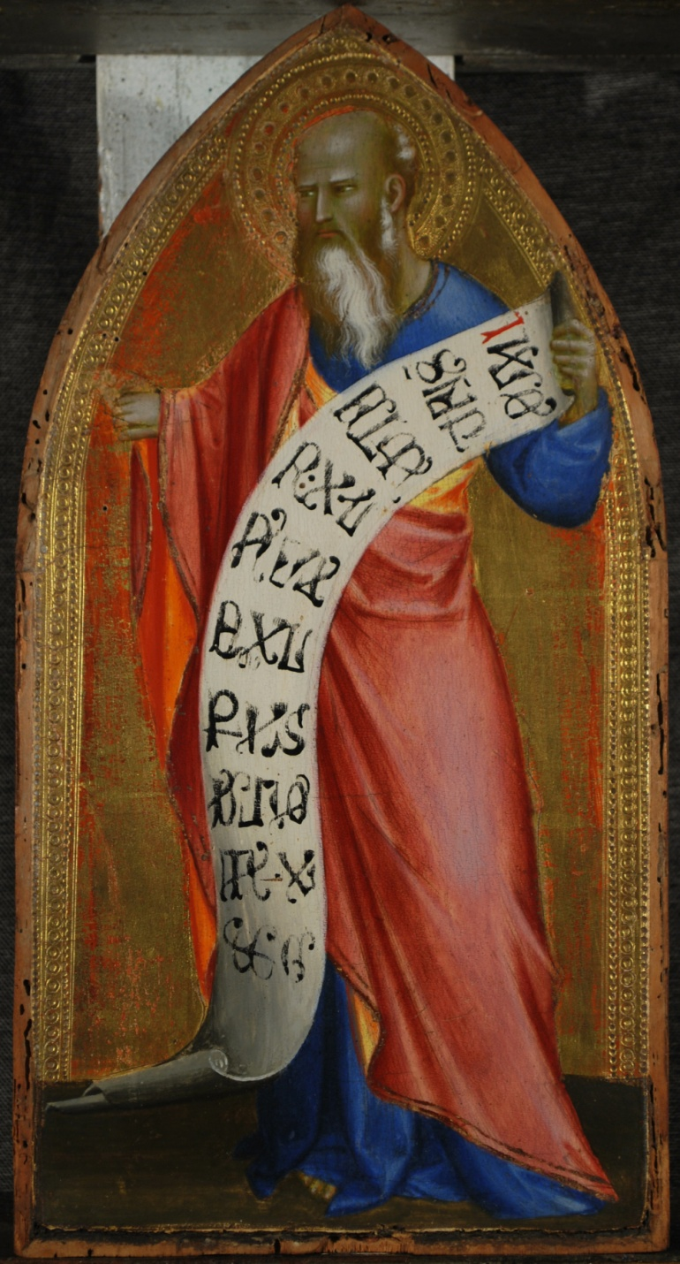
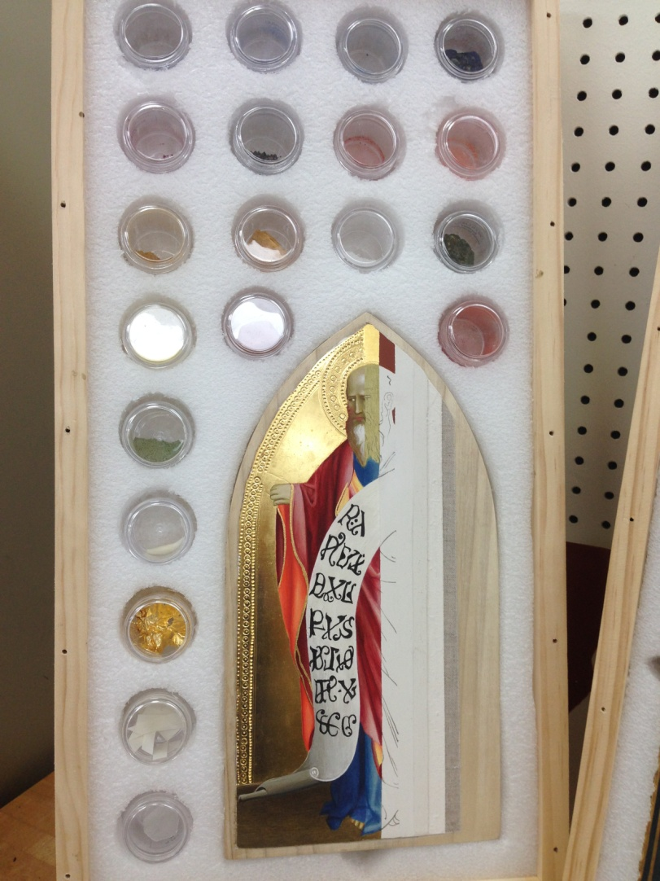
Giovanni del Biondo, Hebrew Prophet
Italian (Florentine)
Egg tempera and gold on a wooden panel ca. 1370
13 ½ x 7 ¼ in. (35.2 x 17.8 cm)
Museo de Arte de Ponce, Puerto Rico

Slide 20
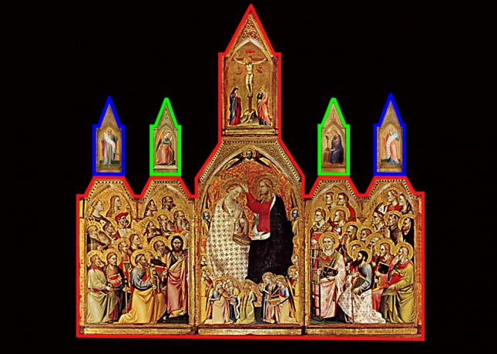
Notes:
Originally part of The Coronation of the Virgin altarpiece in the Oratorio de San Lorenzo at San Giovanni Valdarno in Arezzo, Tuscany, Italy.
Polyptych of multiple wooden panel paintings of gold and egg tempera.
Central panel shows Christ crowing the virgin surrounded by angels and cherubs. Main panels of wings show saints and apostles. Central pennacle shows Christ on the cross with Mary and John and angels. Each wing has 2 pinnacles – inner feature annunciation with Virgin on right and Gabriel on left. Outer pinnacles feature Hebrew prophets. Outer right wing is the piece that we reconstructed in workshop.
Dispersed in three locations : Main section (red) remains in Arrezo, Prophets (blue) at the Museo de Art de Ponce, Puerto Rico, Annunciation (green) Detroit Institute of Art

Slide 21
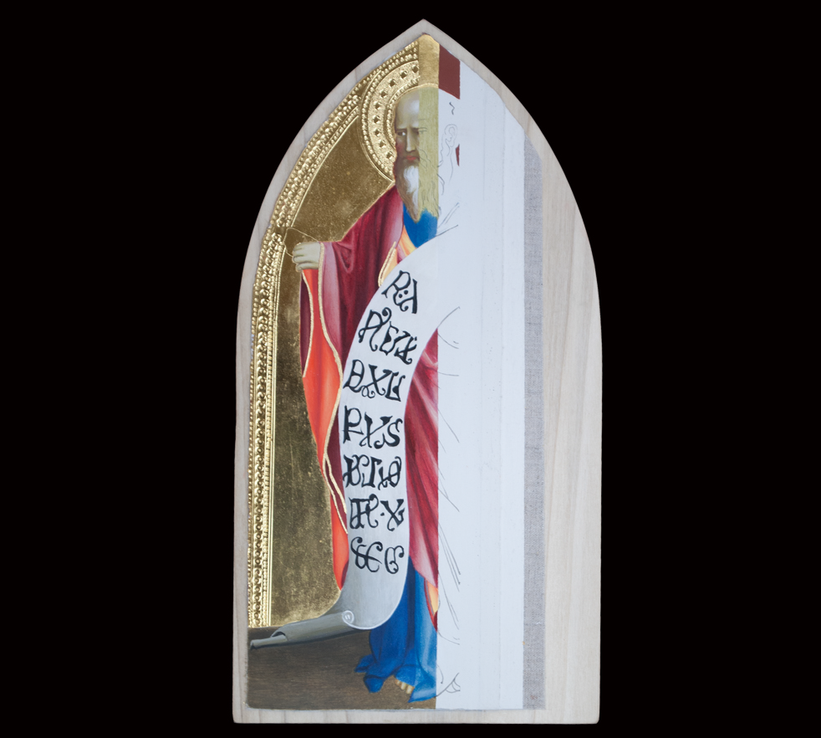
Notes:
Prophet in sections

Slide 22
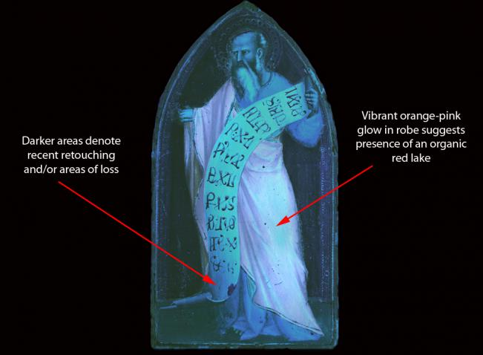
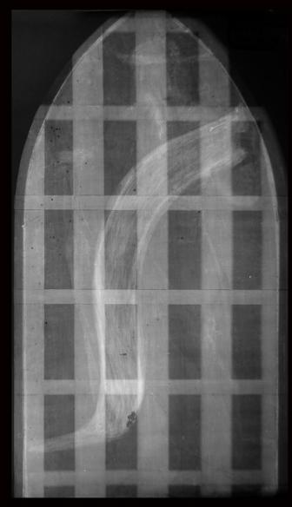
Ultraviolet Illumination Radiograph
Notes:
UV: for infomation on loss of pigment, type of pigment and other treatments and condition
Xray: Construction and condition: Latice = cradeling from earlier conservation. White = lead

Slide 23
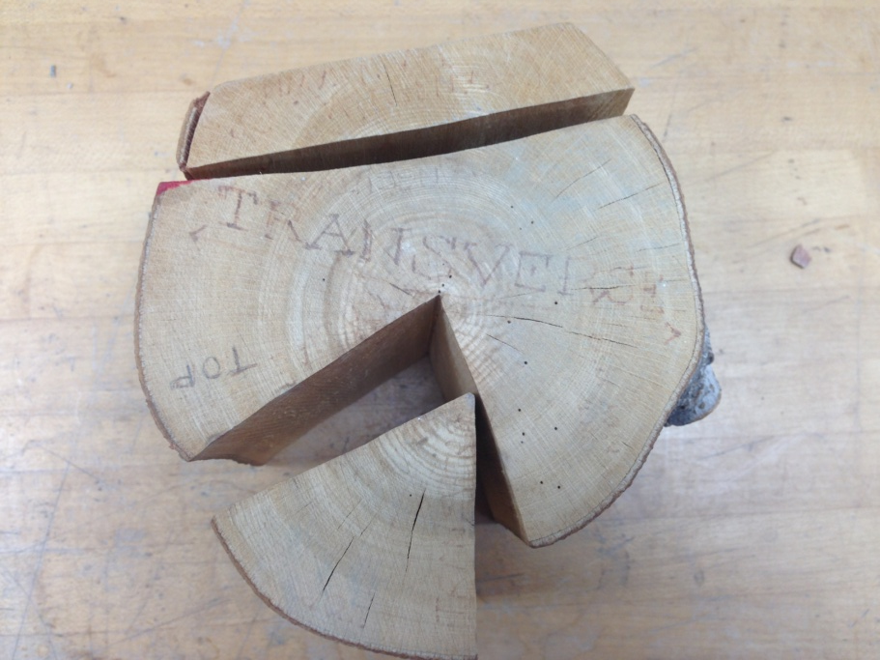
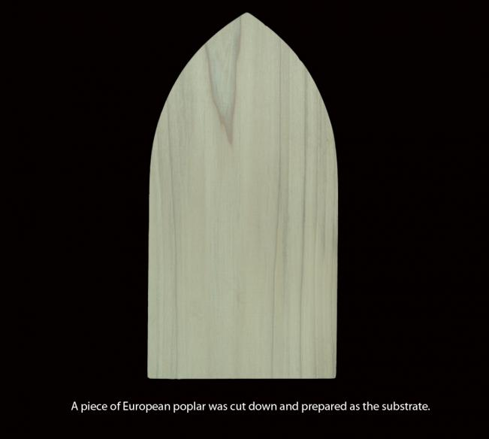
Notes:
Wood selection for least amount of bowing and cracking – European Poplar
Sizing: 2 coats of animal glue

Slide 24
Notes:
Wood selection for least amount of bowing and cracking – European Poplar
Sizing: 2 coats of animal glue

Slide 25
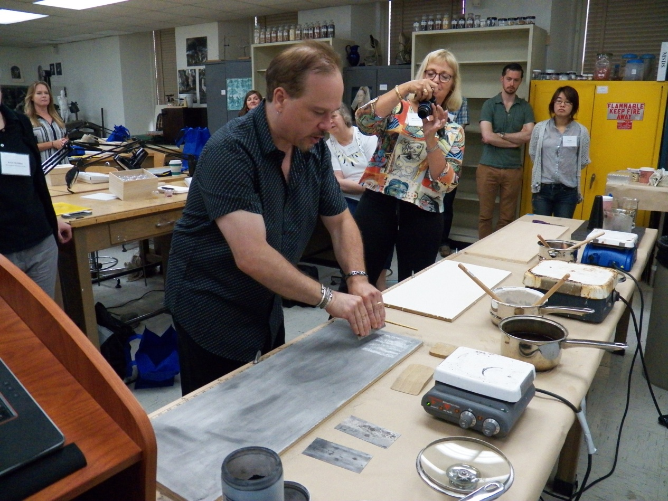
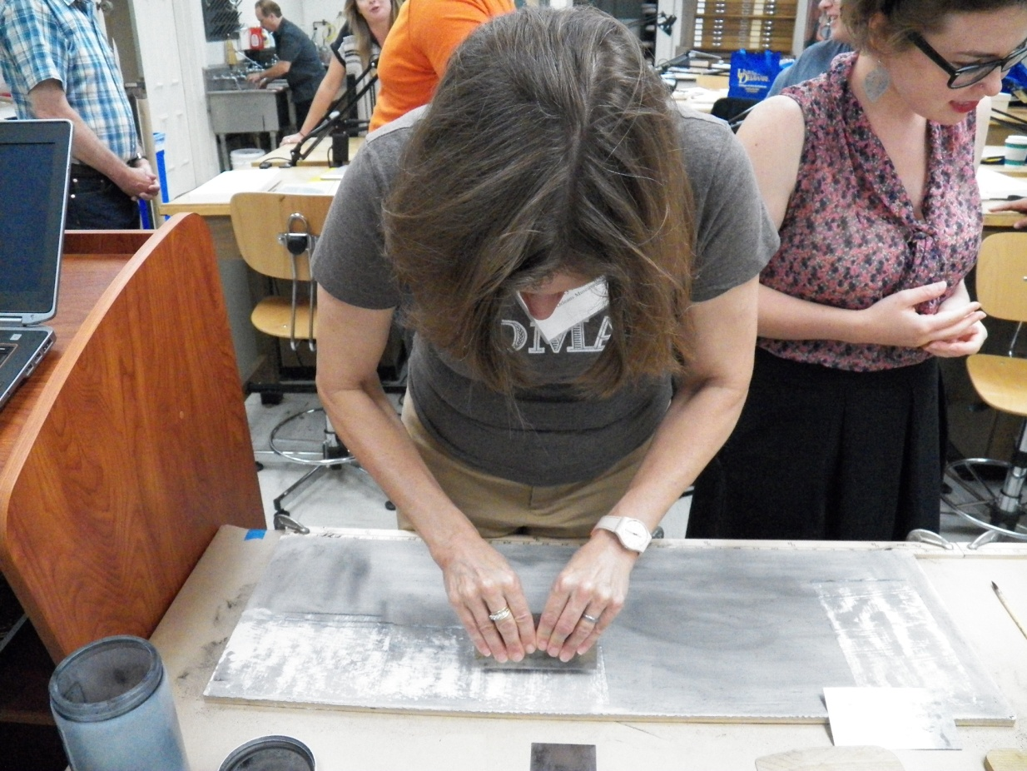
Notes:
Charcoal

Slide 26
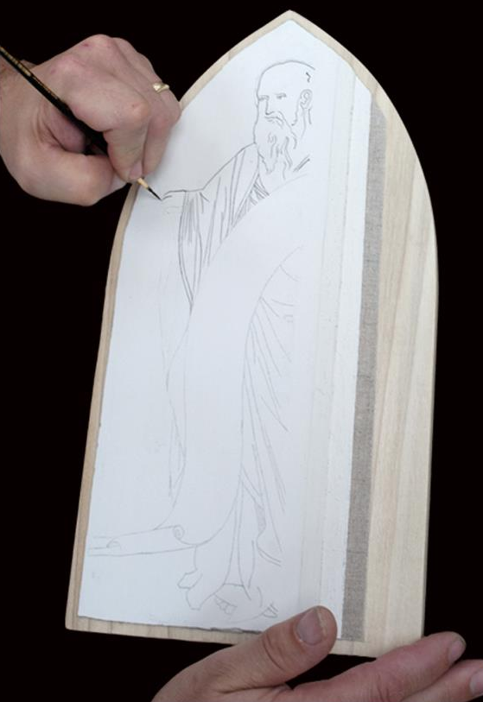
Notes:
Underdrawing next and reinforced with black ink

Slide 27
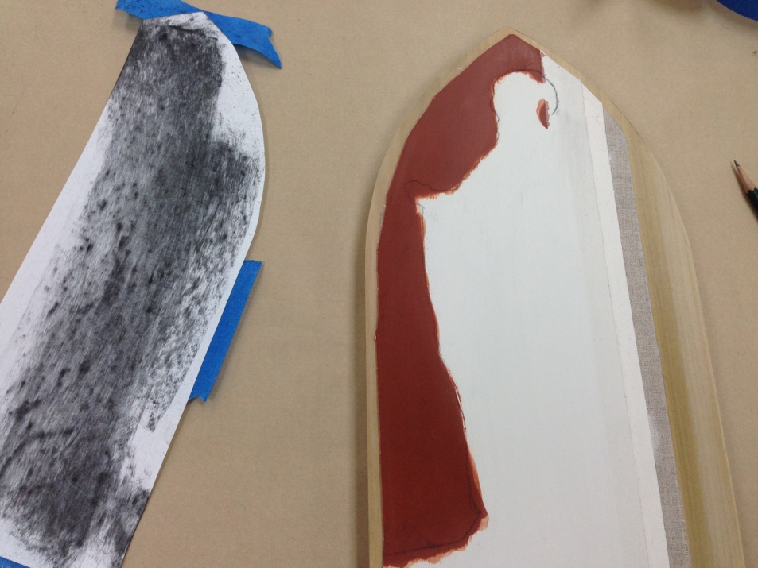
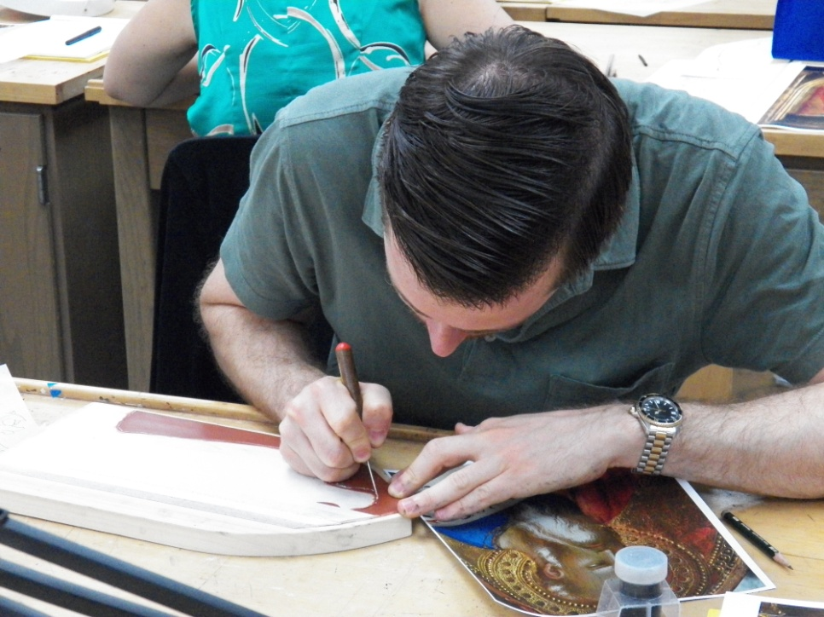
Notes:
Stylus used to reinforce line for bole and gilding.
We got with bole because of time. – transferred line with charcoal, used stylus

Slide 28
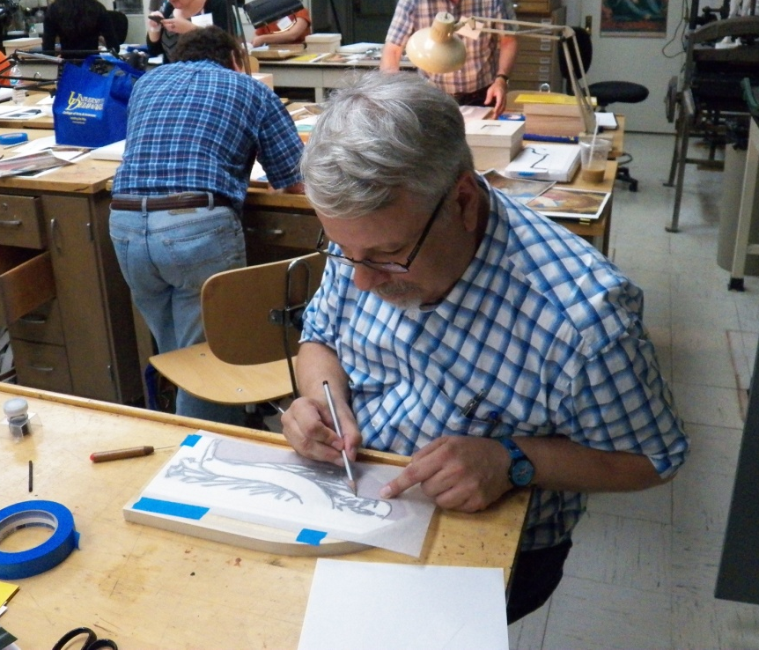
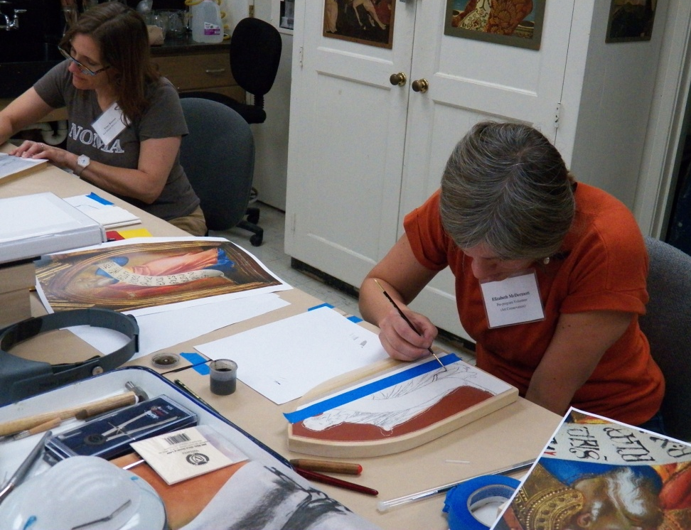
Notes:
Red bole – mixture of red clay and animal glue
Need many layers and takes awhile to dry, so done ahead for our one week workshop.
Charcoal transfer, black ink

Slide 29
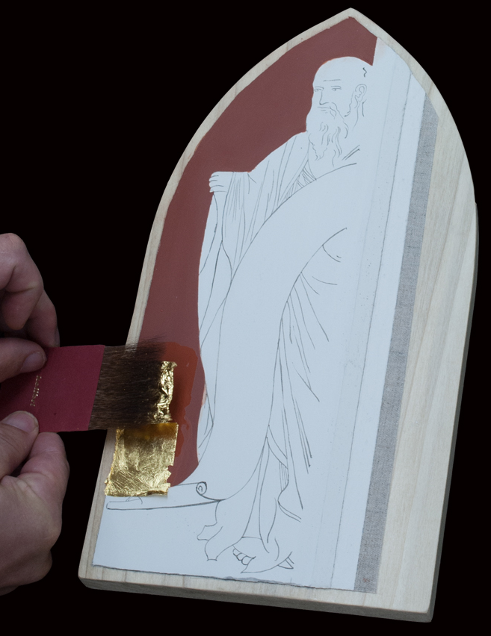
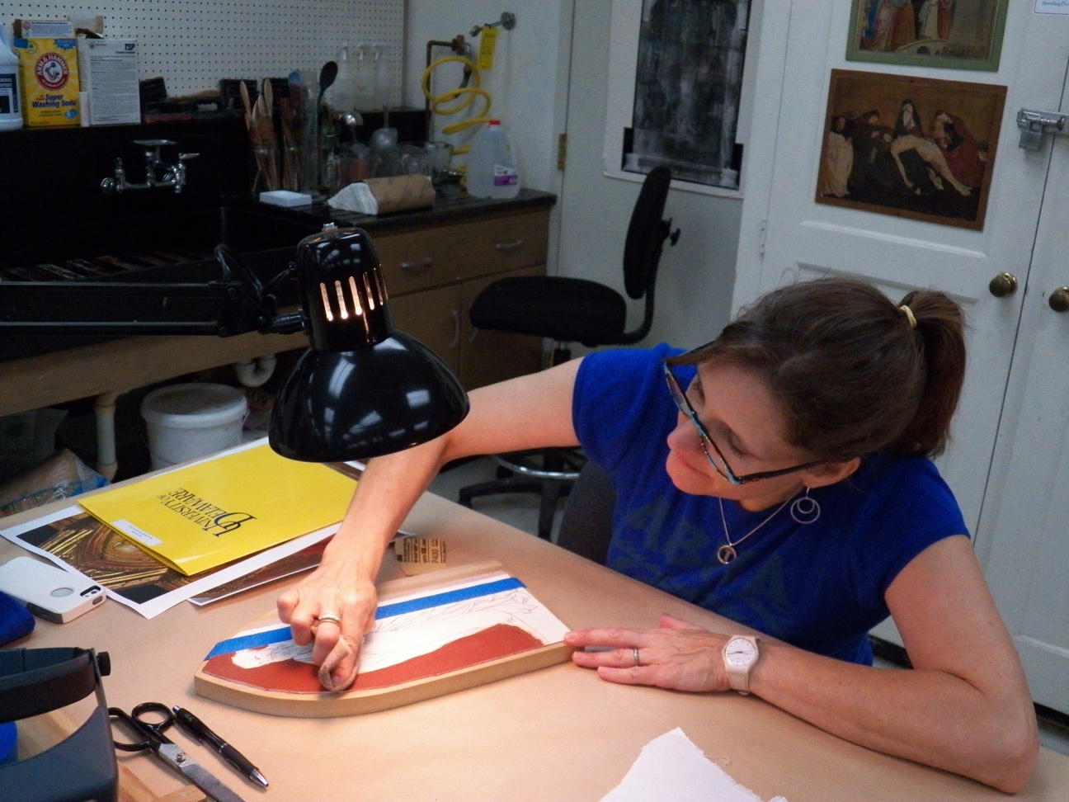
GILDING
Notes:
Purpose of bole – deeper (red), sticky

Slide 30
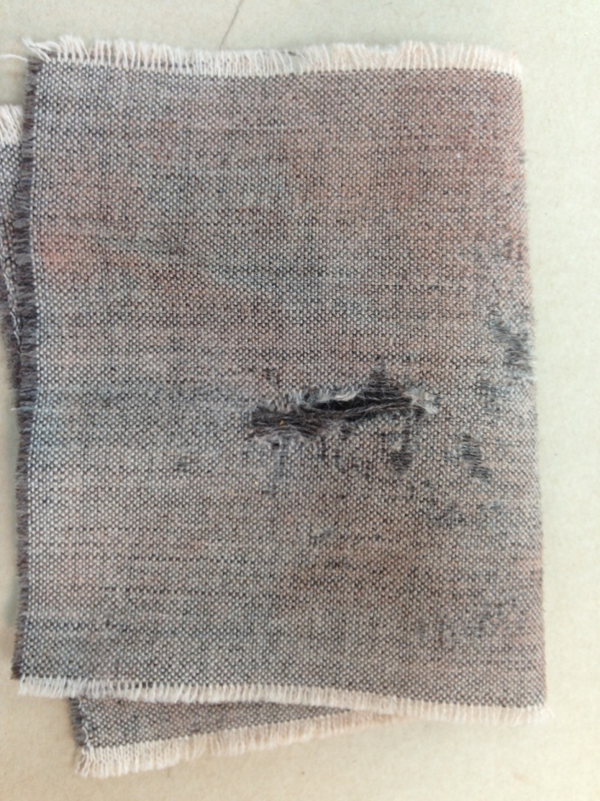
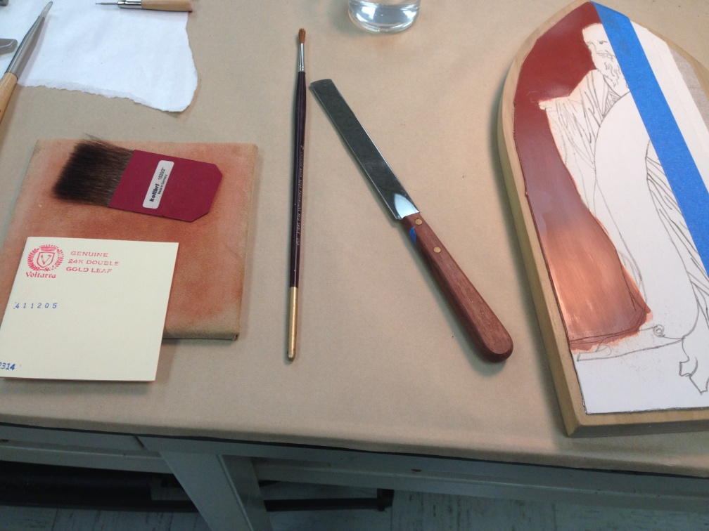
Notes:
Tools:
Horsehair cloth, gilders knife, gold leaf, water, brush, flat brush
Demonstrate getting static electricity

Slide 31
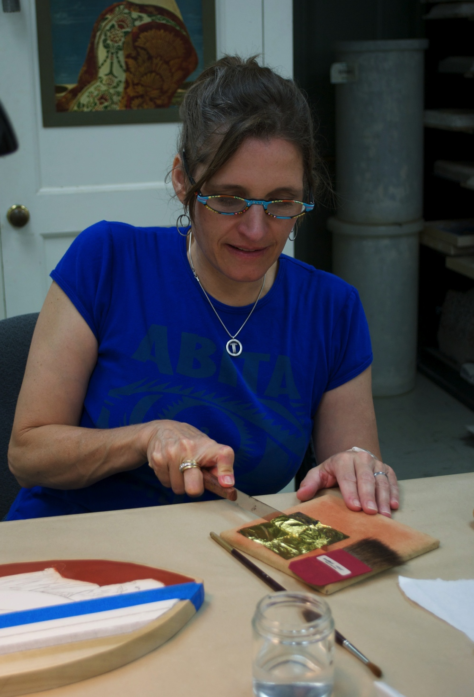
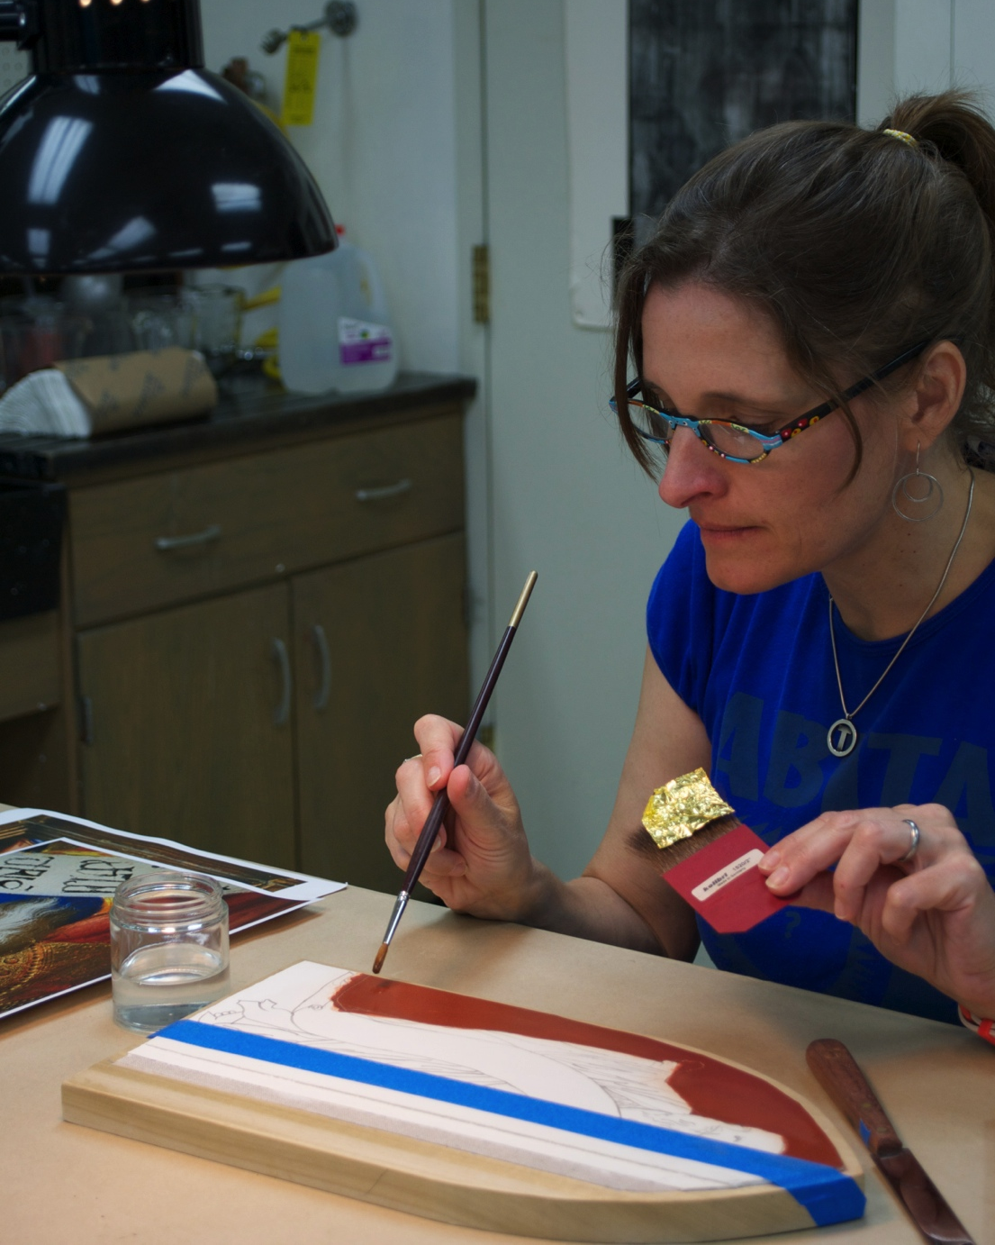
Notes:
Cut, transfer, water…

Slide 32
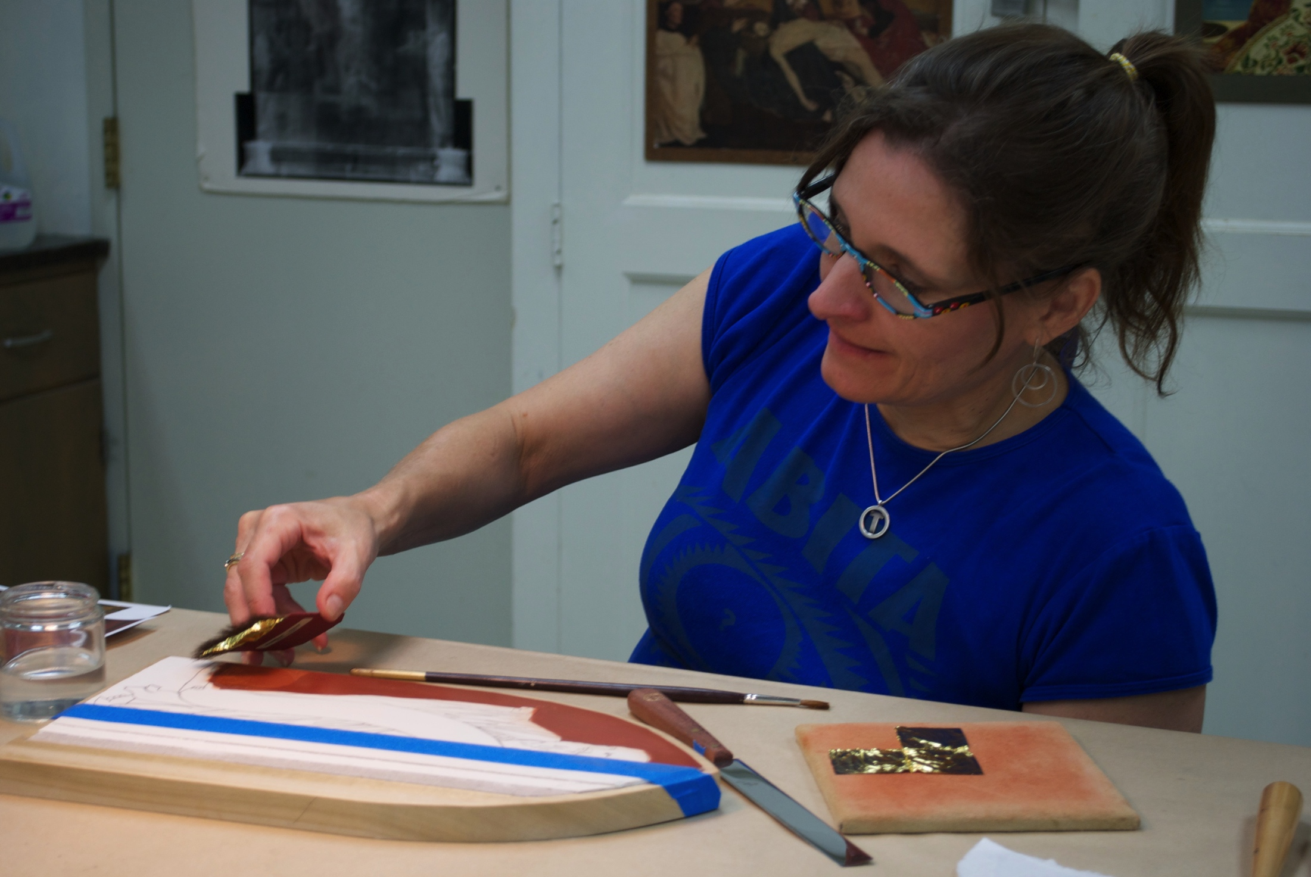
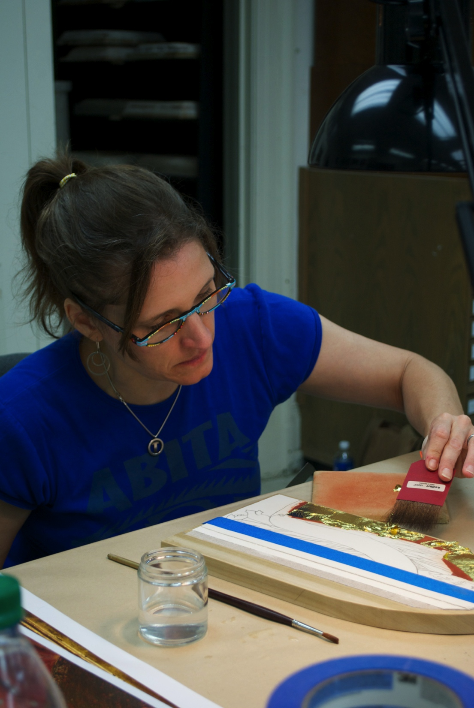
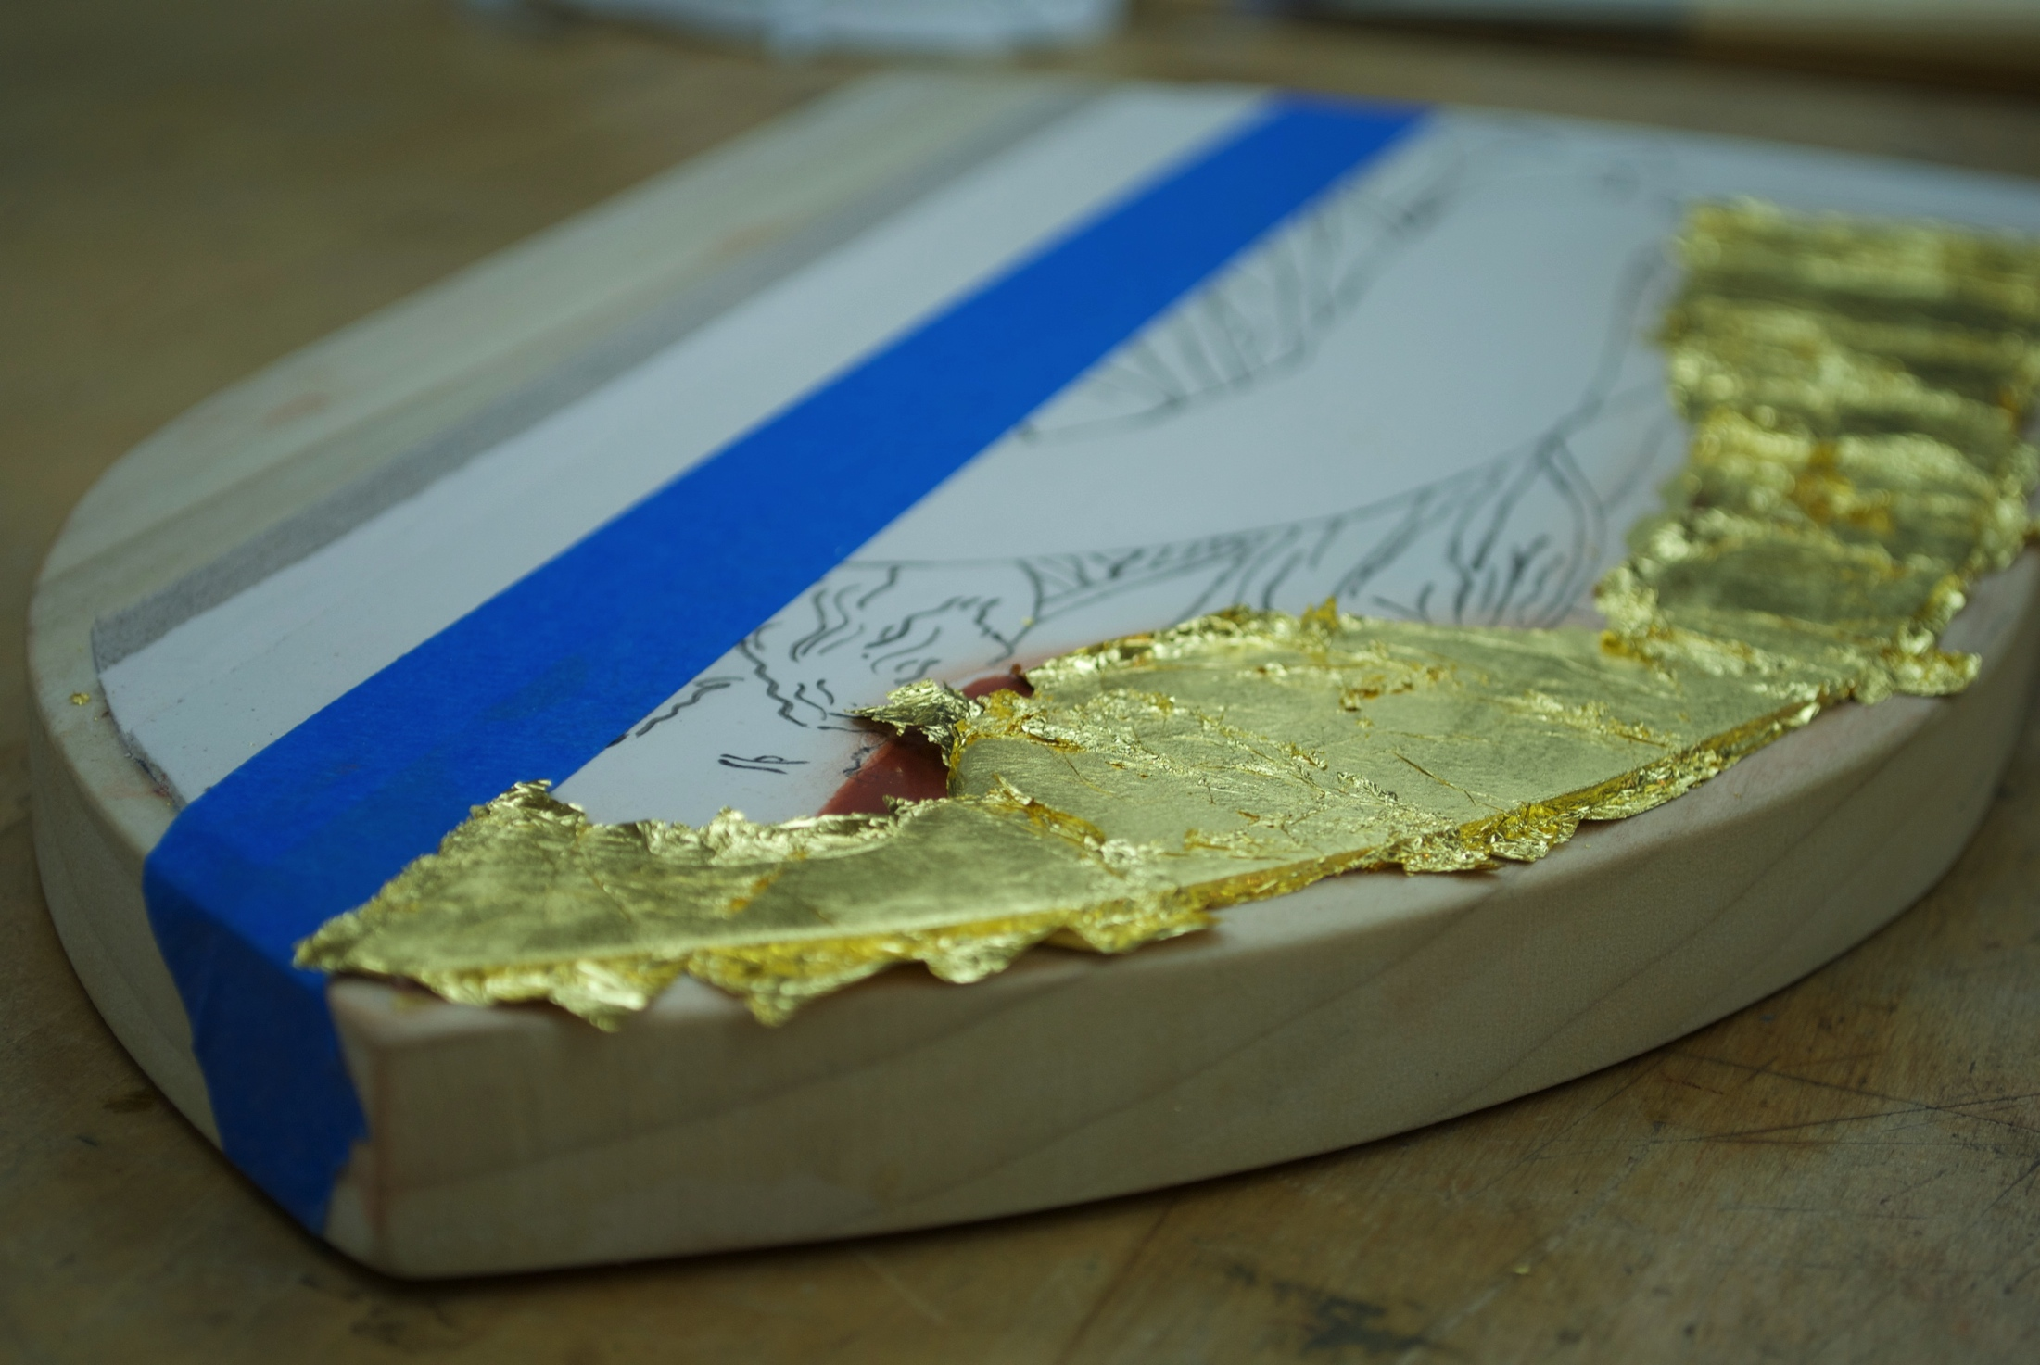
Notes:
Cover space, let dry, brush off loose gold leaf paper, TWO LAYERS

Slide 33
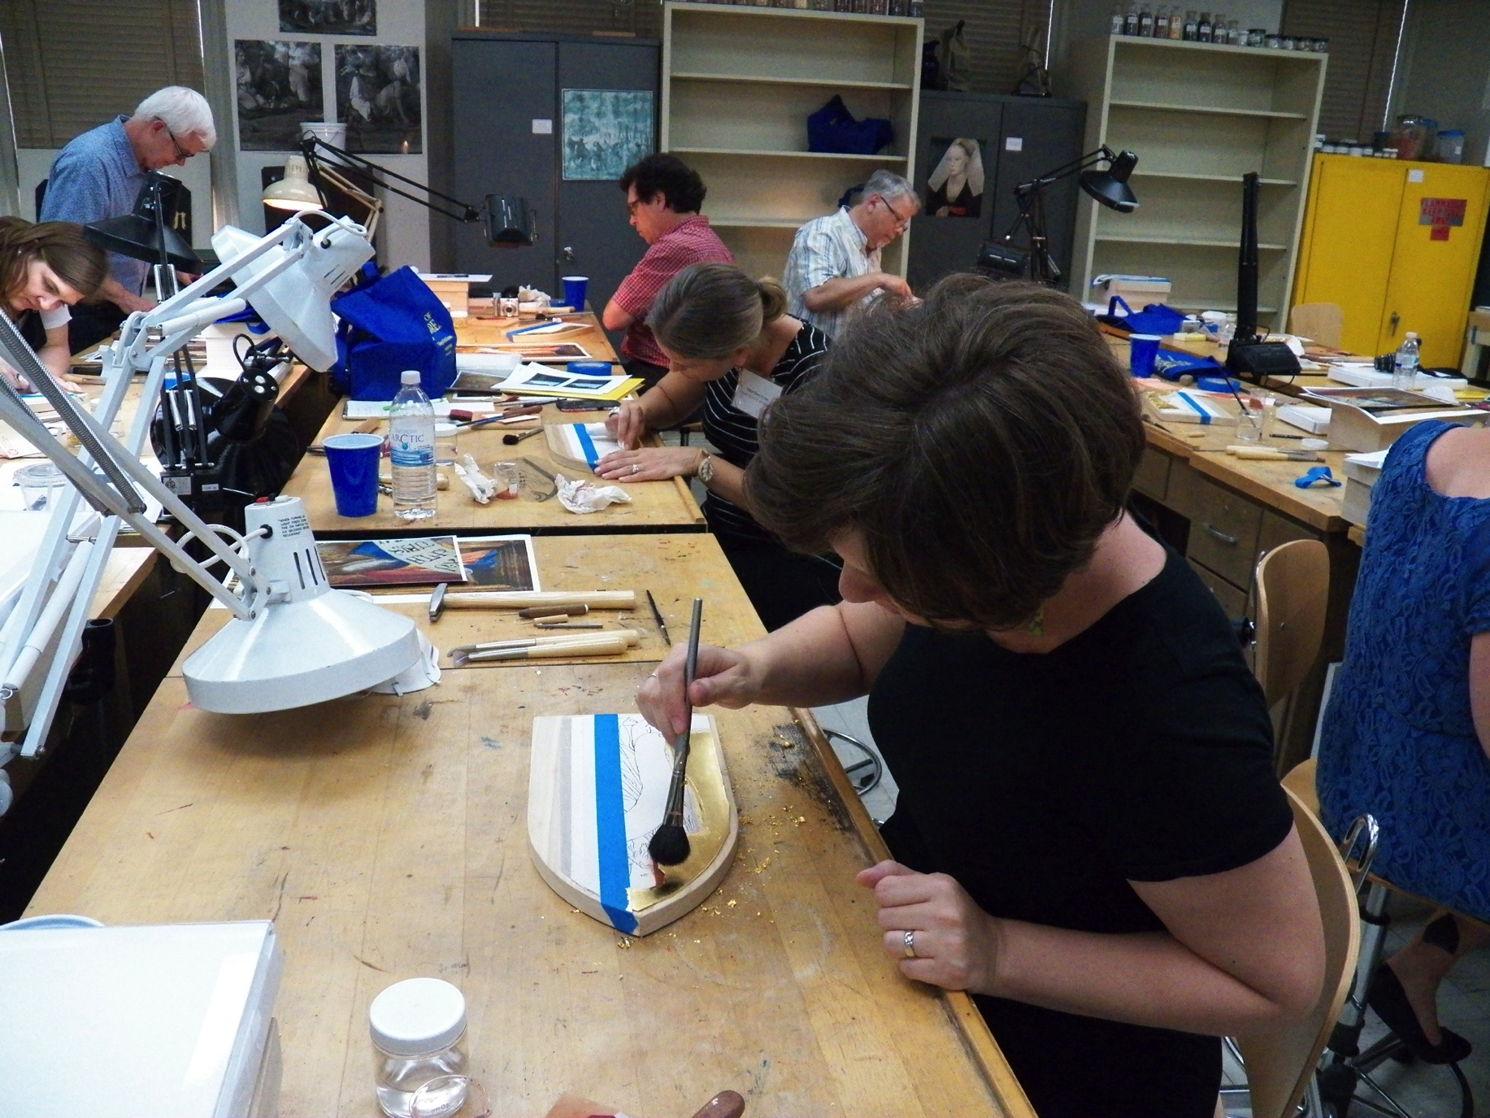
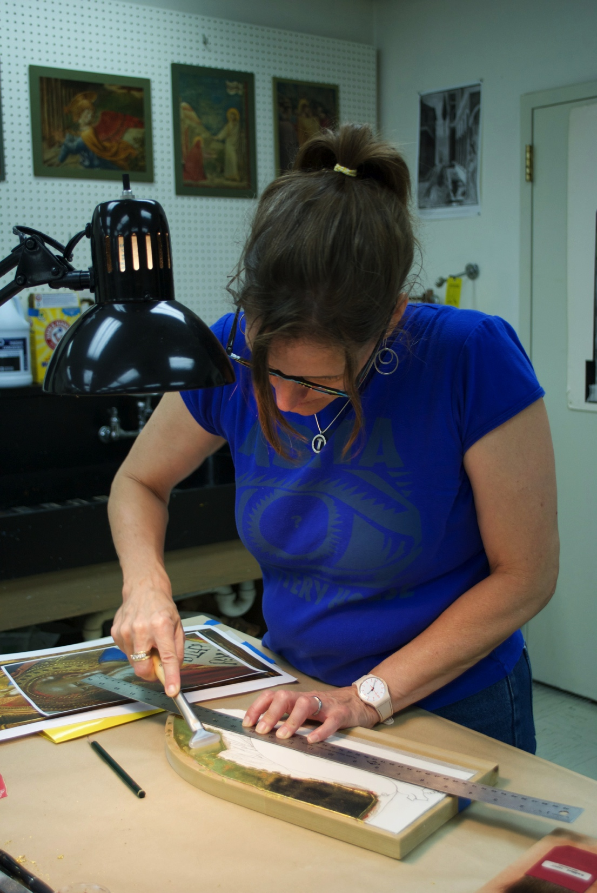
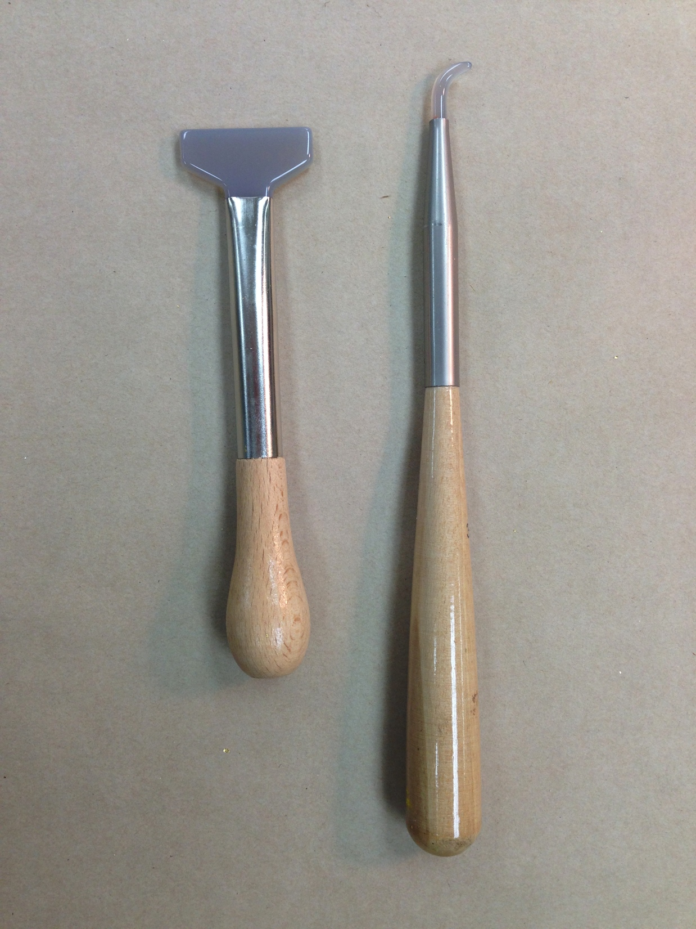
Notes:
Brush, burnish– dogs tooth, polished agate
Today’s GL very thin

Slide 34
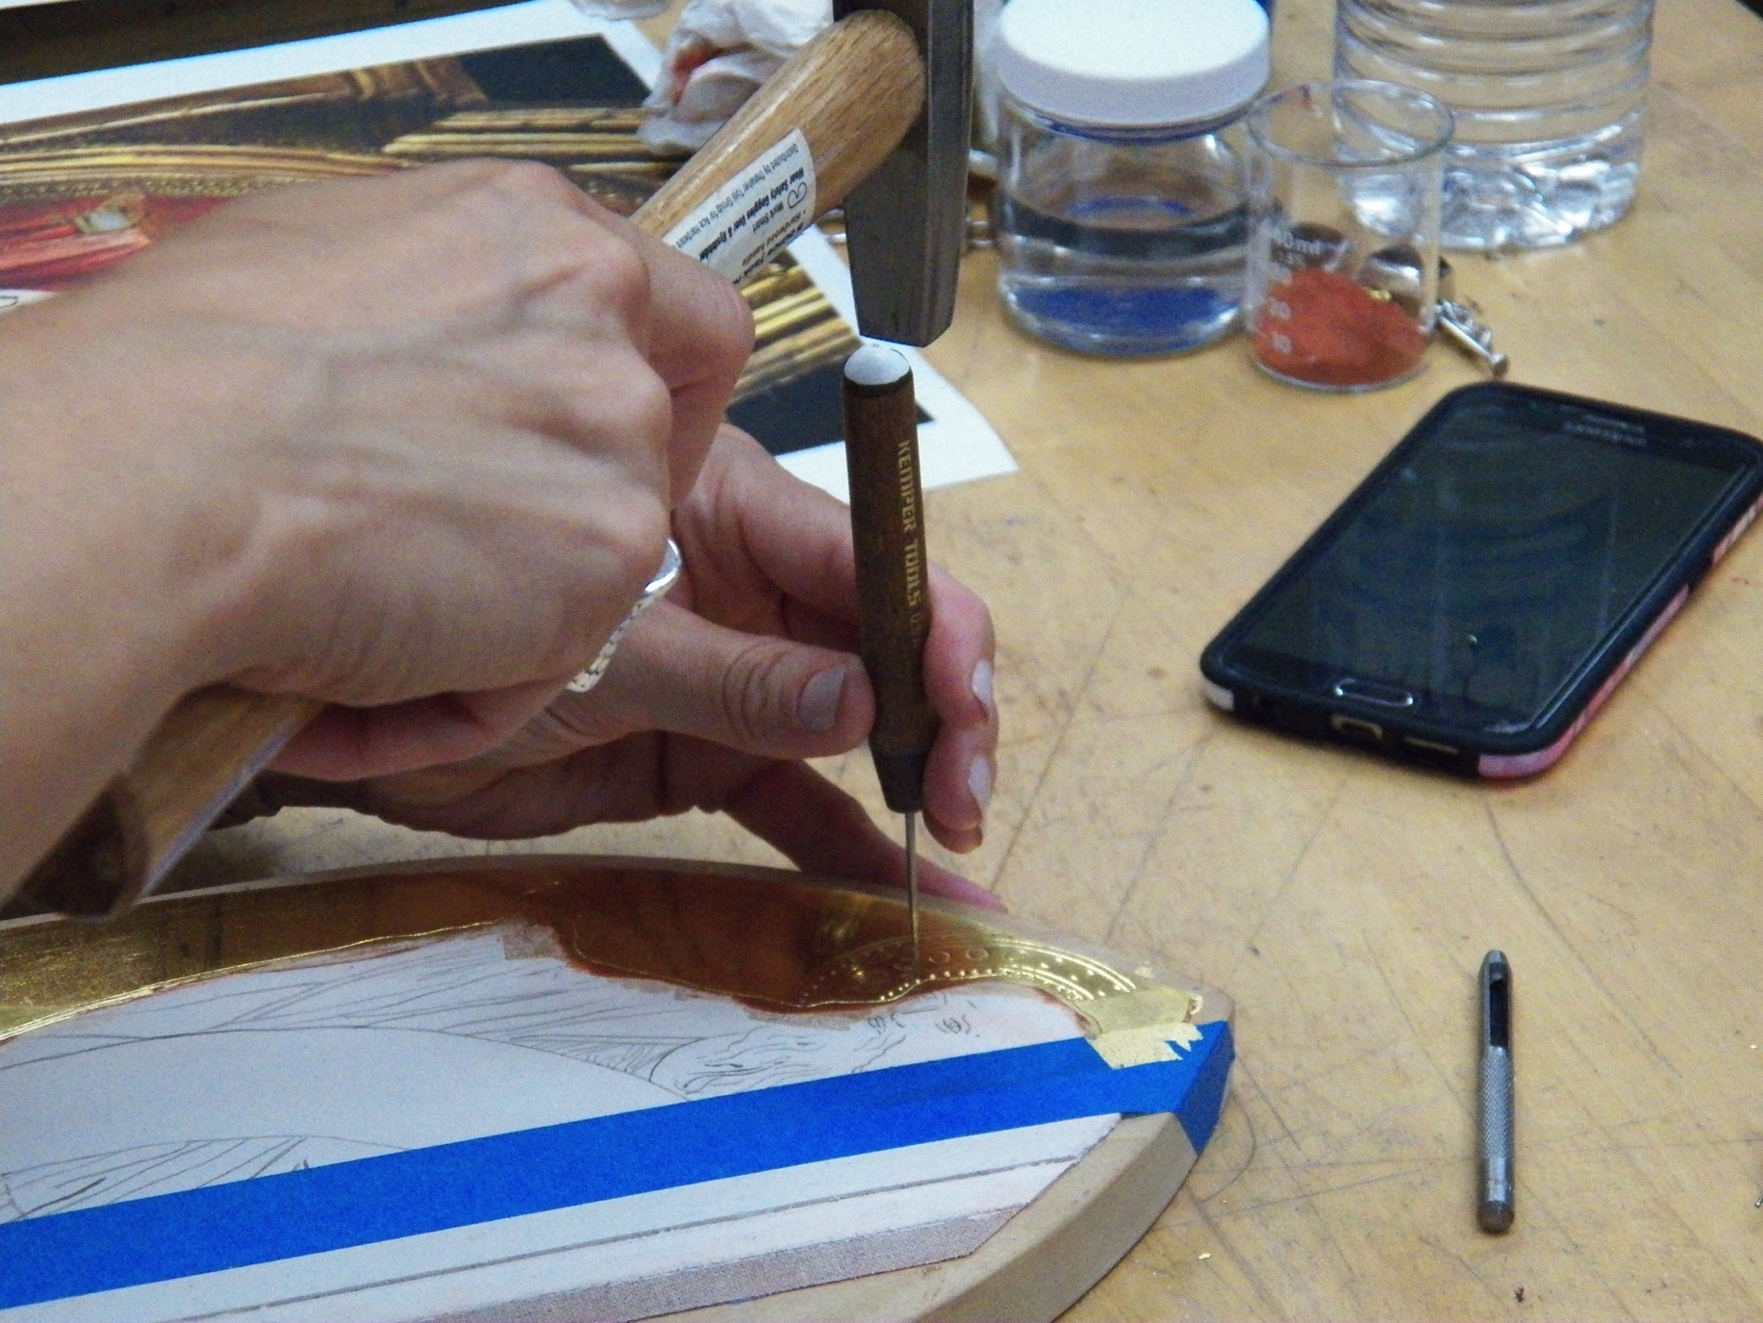
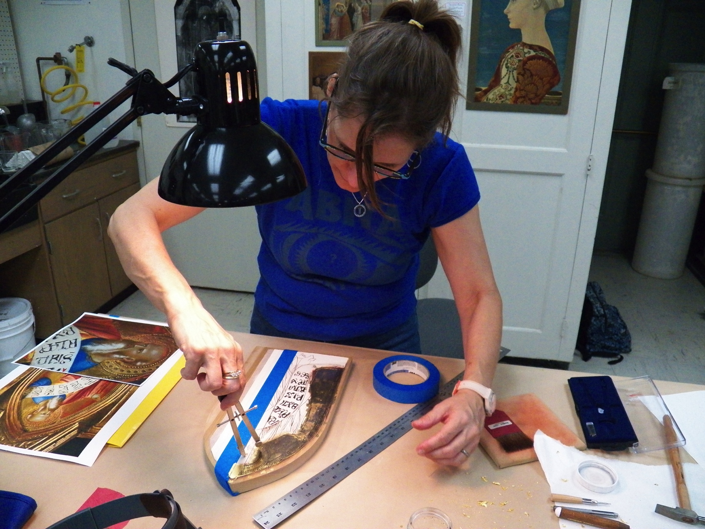

Slide 35
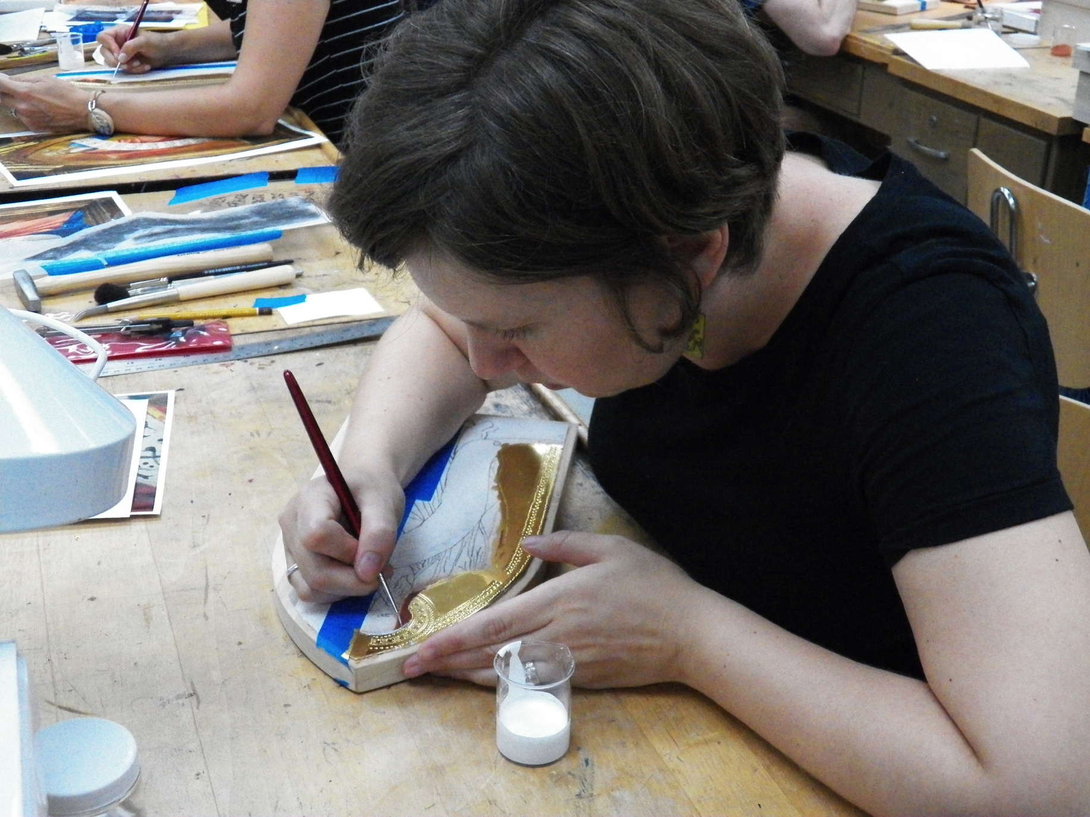
Notes:
Lead white and animal glue used to paint over gold leaf that had crossed incised line.
Incising important because can’t see lines.
Notice change in position of hand – this was true to original
Incision from compass point filled with glue mixture as well.

Slide 36
Painting with Egg Tempera
Notes:
Tempera is traditionally created by hand-grinding dry powdered pigments into a binding agent or medium, such as egg, glue, honey, water, milk (in the form of casein) and a variety of plant gums.
Tempera painting starts with placing a small amount of the powdered pigment onto a palette, dish or bowl and adding about an equal volume of the binder and mixing. Some pigments require slightly more binder, some require less. A few drops of distilled water are added; then the binder (egg emulsion) is added in small increments to the desired transparency. The more egg emulsion, the more transparent the paint
Blue robe painted with mixtures of Azurite and lead whiet

Slide 37
Notes:
Small brushes, thin lines
Tempera paint dries rapidly. It is normally applied in thin, semi-opaque or transparent layers. Tempera painting allows for great precision when used with traditional techniques that require the application of numerous small brush strokes applied in a cross-hatching technique. When dry, it produces a smooth matte finish.
Add dark, blend through applications of lighter colors in cross-hatch. Dries fast!
Blue glazed with ultramarine—most expensive, gives deeper color
The yellow inner lining of the robe was created using mixtures of lead-tin yellow, red lead, and small additions of vermilion. The deeper red orange on the left of the panel was created using primarily red lead with vermilion in the darker areas with small additions of lead-tin yellow to highlight.

Slide 38
Notes:
The deep crimson robe was created using multiple steps. The general method was to paint darker areas first. The painting began with a deep crimson made from red lake with small additions of lead white and yellow earth. Lighter colors were hatched over the junctures between color changes to create the appearance of a smooth gradation. This was continued until the transitions on the robe were seamless. A transparent glaze of red lake was then applied over the whole to unify and create a more saturated color effect. The deepest shadows were reinforced using additional glazes of red lake and small amounts of carbon black.

Slide 39
Notes:
The flesh on Early Italian egg tempera paintings was usually underpainted in a greenish tone. It was painted using a mixture of green earth, yellow earth, and lead white.

Slide 40
Notes:
As before, the flesh was painted starting with the medium dark colors composed of the same pigments but with far less lead white. Slightly lighter colors were hatched over these to create gradations. The original underpainting color was glazed over transitions to make them smoother. Lighter mixtures were then used to create pearlescent, lighter areas and eventually highlights. Thin, pure lead white was hatched over regions of the beard to create the appearance of hair. This was then glazed back to diminish the contrast. Finally, the brightest portions of the beard were painted using opaque lead white. Details were painted using darker mixtures of the same pigments and the lips and cheeks were warmed up using a mixture of vermilion, red earth, and a small addition of lead white.

Slide 41
Notes:
Lettering: transferred using carbon, painted with carbon black

