Slide 1
Agenda
Announcements & updates
Apprentice Docent check-in
Lecture & discussion – Planning a Tour
Group activities in galleries

Slide 2
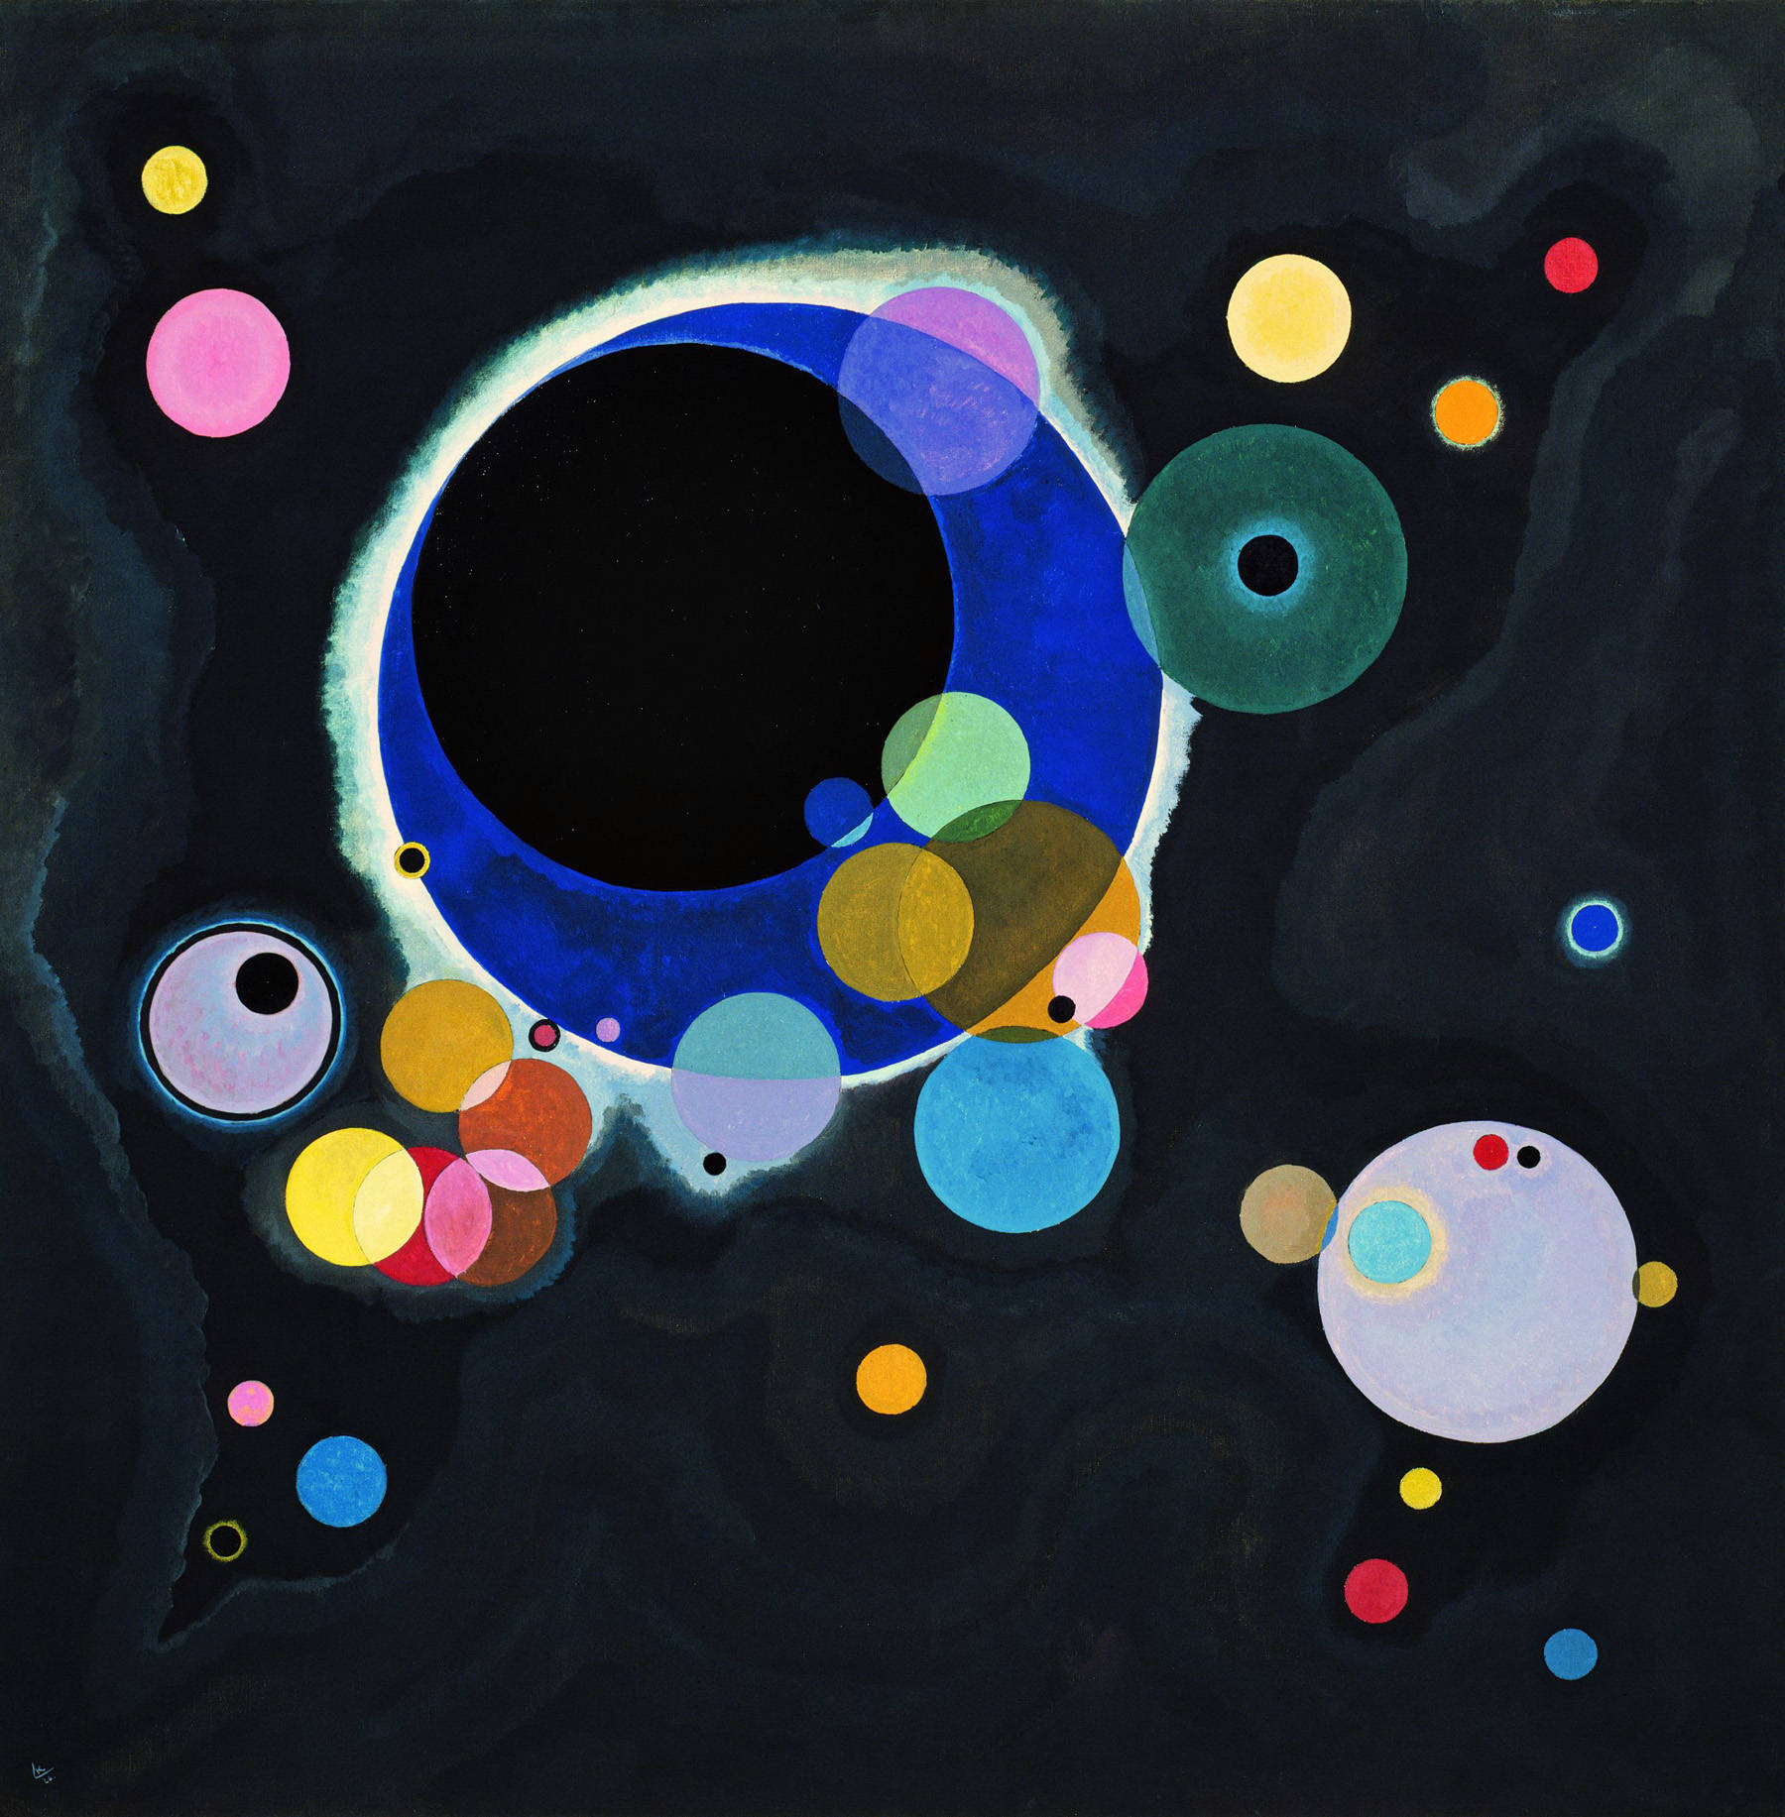
Announcements
Welcome back!
Schedule adjustments
DAB notices
Questions & concerns

Slide 3
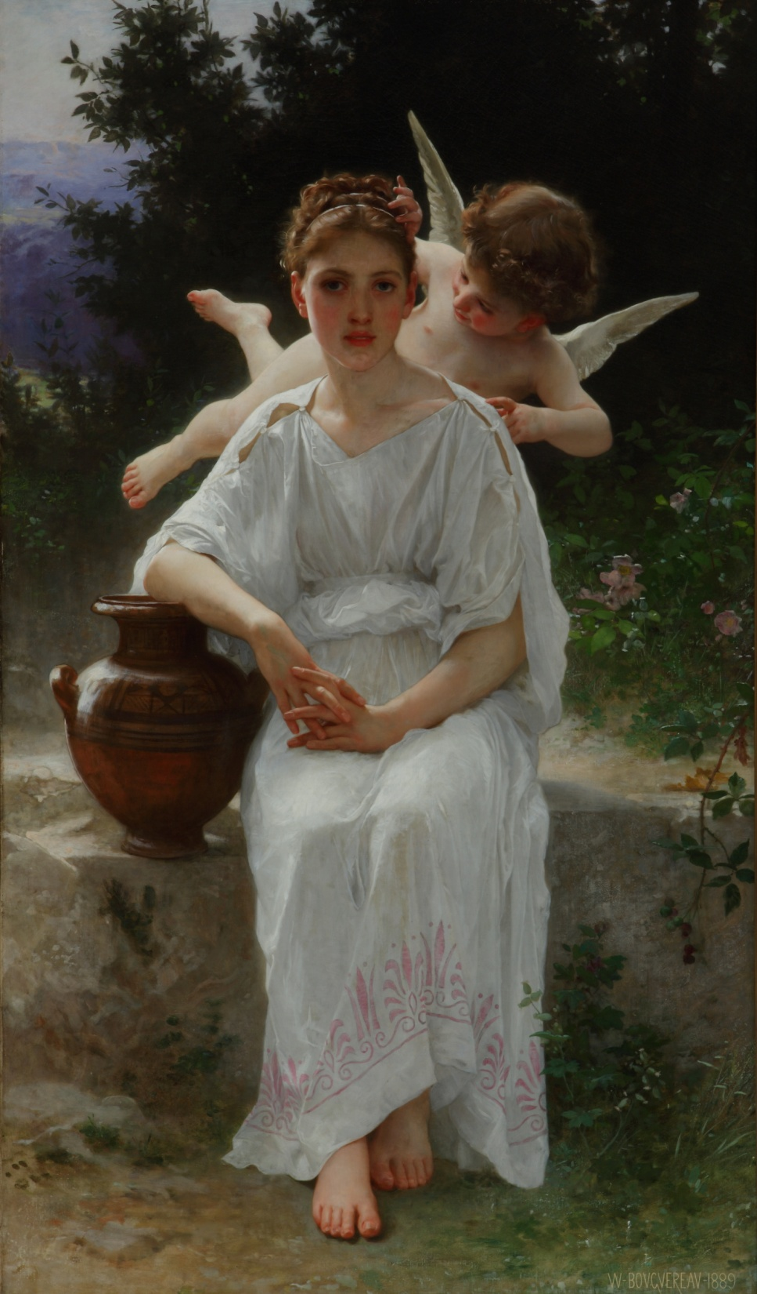
Notes:
What is going on here? Stressing the importance of making discoveries for yourself!
Visual Thinking Strategies
Q1) What is going on in this picture?
Q2) What do you see that makes you say that?
A3) What more can we find?

Slide 4
THE INQUIRY METHOD
The Inquiry Method is a process based on the belief that one is able to learn more when you think for yourself rather than being told facts. The Inquiry Method places emphasis on active learning and encourages personal responses, reasoning and exploration. There is no wrong answer! The Inquiry Method invites all to participate and makes visitors feel comfortable in the museum environment.
Why do we utilize this method?
Focuses visitors' attention on objects
Slows the pace, magnifies what is seen and amplifies what is felt
Helps transition from visitor to learner
Helps viewers discover concepts for themselves
Actively involves viewer in creative and critical thinking
Makes participants self-aware of questions to ask when looking at art

Slide 5
Notes:
I can tell you about Bouguereau, but you will remember more if you make the discoveries!
William-Adolph Bouguereau was a well-known and influential artist in France from 1850 - 1900. Born in 1825 to a family of wine and oil merchants, Bouguereau left the family business to study art at the Écoles des Beaux Arts (Schools of Fine Arts) in Bordeaux and then in Paris. A perfectionist with a strong work ethic, the artist won the Prix de Rome in 1850 and was inducted into the Legion of Honor in 1859. His work was lauded by contemporary proponents of Academic art, however the pristine, neoclassical style fell out of favor as avant-garde styles like Impressionism grew more popular. A revived interest in the Academic style has caused Bouguereau to be recognized once again as one of the supreme academicians in the great age of the Paris Salon.
Nineteenth Century
• caught between nature and encroaching industrial revolution - urban centers, rising middle class
• Freud
• Darwin: Origin of Species
• Marx: unification of workers all over world
• music: Ravel and Debussy
• Literature: Balzac, Zola, Hugo and Dickens, Twain, Austin
• scientists: better understanding of how eye sees light and color

Slide 6
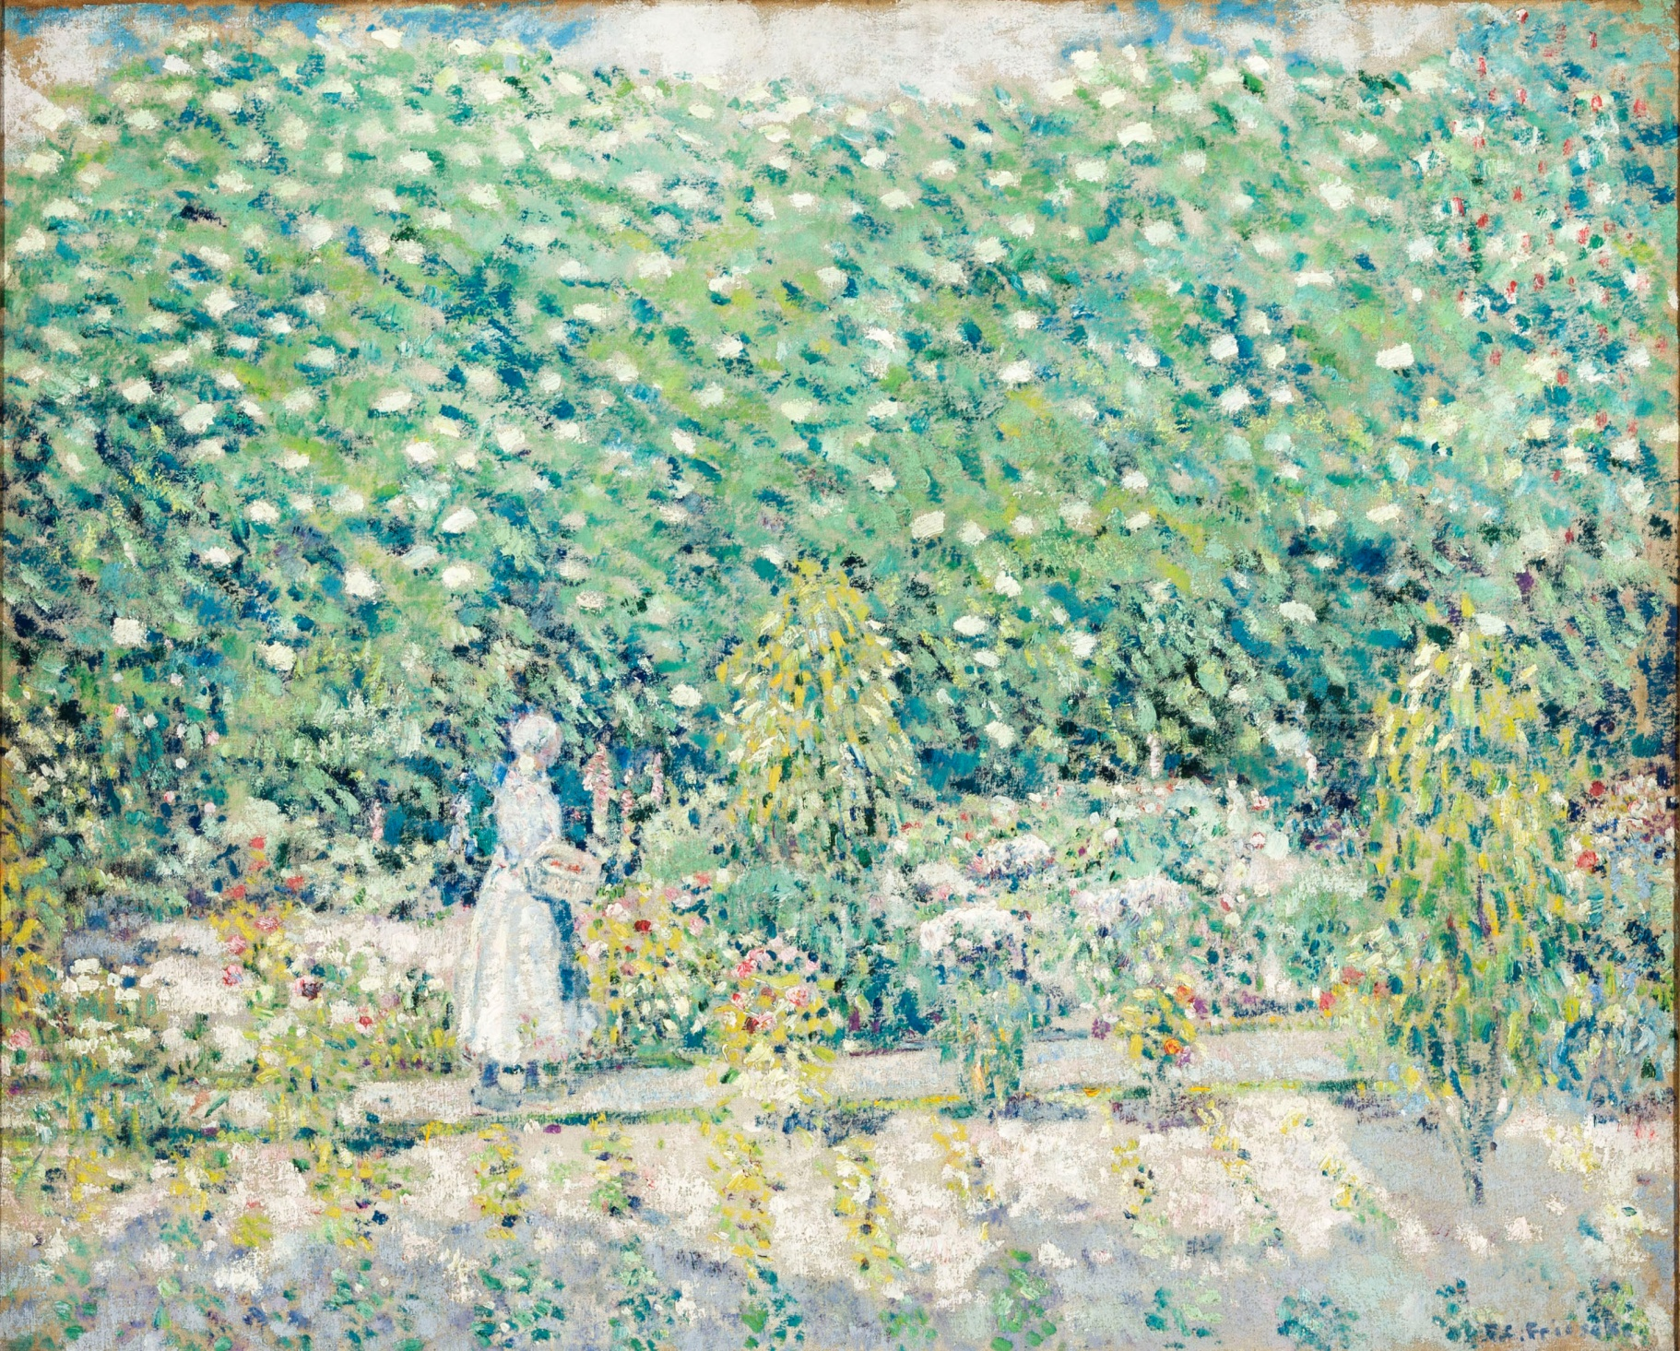
Notes:
I see, I think, I wonder
Frederick Frieseke (American, 1874-1939), In the Garden, Giverny, circa 1900-1905, Oil on canvas
Born in Michigan in 1874, Frederick Frieseke first studied art at the Art Institute of Chicago and then the Art Students League of New York before moving to Paris in 1897. While studying with several academic painters at the Academie Julian, he adopted an Impressionist style then popular with American expatriate artists. Many of them congregated in Giverny, the village northwest of Paris where Claude Monet had lived since 1883. Frieseke spent his first summer in Giverny in 1905, and the following year moved into a cottage adjoining Monet’s property where he continued to summer until 1920.

Slide 7
Questioning
Observation Questions
How would you describe this object to someone who has never seen it?
What is going on in this work of art?
How would you describe the colors, lines, shapes, textures of this work?
Is there anything about this object which is surprising or new to you?
How do you think this object was made?
Comparison Questions
How are these two objects alike?
How are they different?
Have you ever been to a place like this?
Does this work remind you of a place or event?

Slide 8
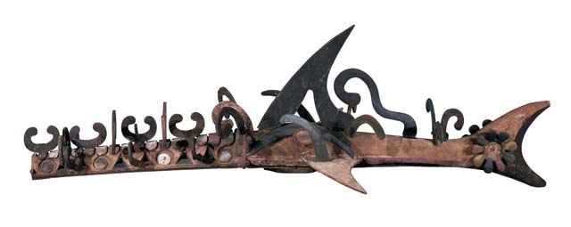
Planning a Tour
Theme
Explain what your tour topic will be
Give a preview of the tour
Have a unifying concept
Object Choice
Present content to support the theme
Support your ideas with thoughtfully selected objects
Plan a logical progression through the galleries

Slide 9
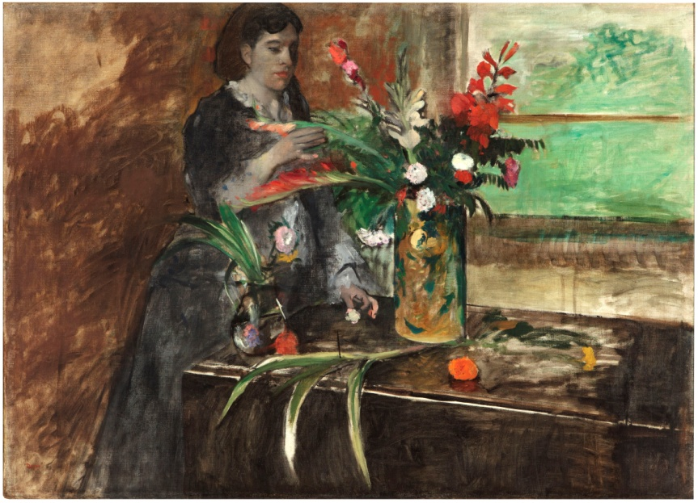
Transitions (segues)
Give unity and coherence to ideas
Make it easy for group to follow from one idea to another
Preview and summarize
Ideas for transitions-comparison, questions, look fors

Slide 10
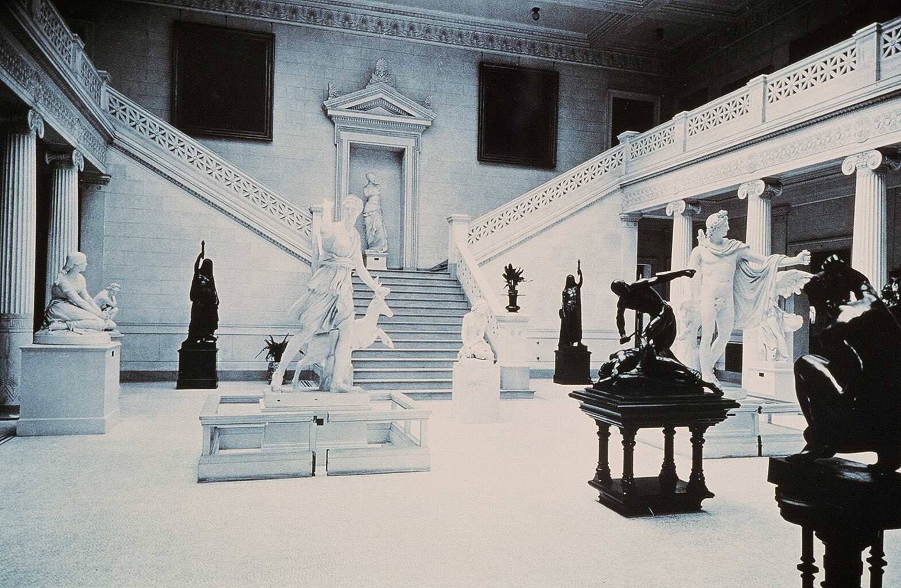
Introduction
Introduce yourself and welcome the group to NOMA
Briefly explain your theme and give the approximate length
Remind group of museum manners (if applicable)

Slide 11
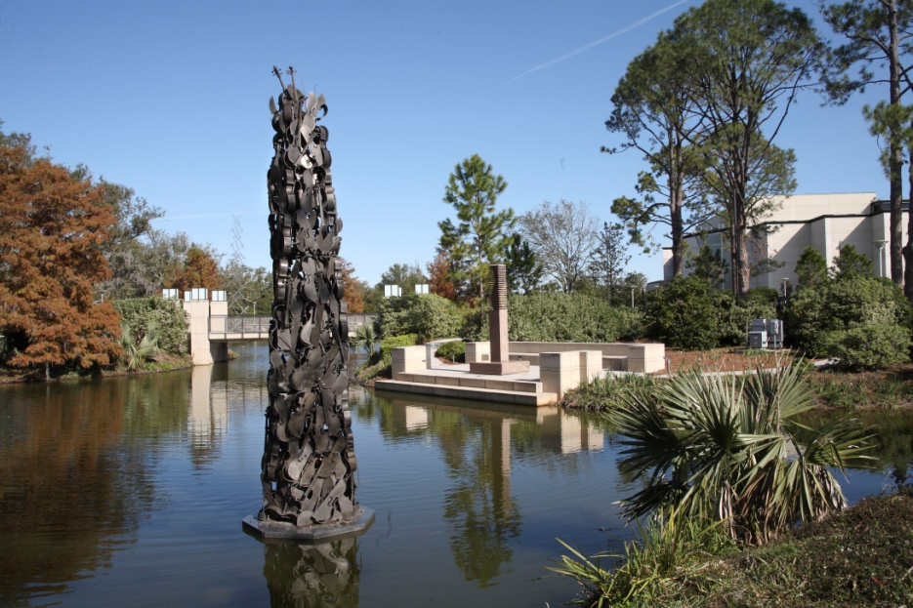
Conclusion
Restate theme and summarize
Encourage group to spend time in galleries or return
Thank group for participating and leave them with information about events, membership, sculpture garden, etc.

Slide 12
Themes
Visual Art Approach
Elements of Art
Methods & Materials
Language Arts Approach
What’s the Story?
Describe it!
Social Studies Approach
Continents and Cultures
My Country, My State
Special Exhibition
Museum Highlights
Develop your own!
Architecture
Landscapes
Portraiture
Sculpture
Art History
Food in Art
Around the World
Louisiana Art
Modern Art
Specific color
Flowers

Slide 13
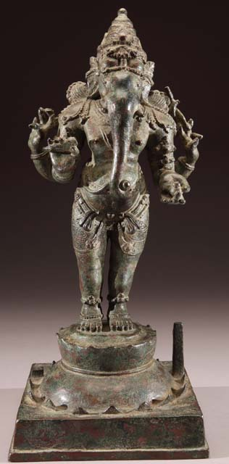
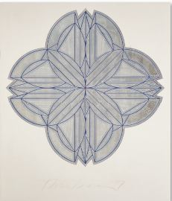

Slide 14
Notes:
Spend time looking

Slide 17
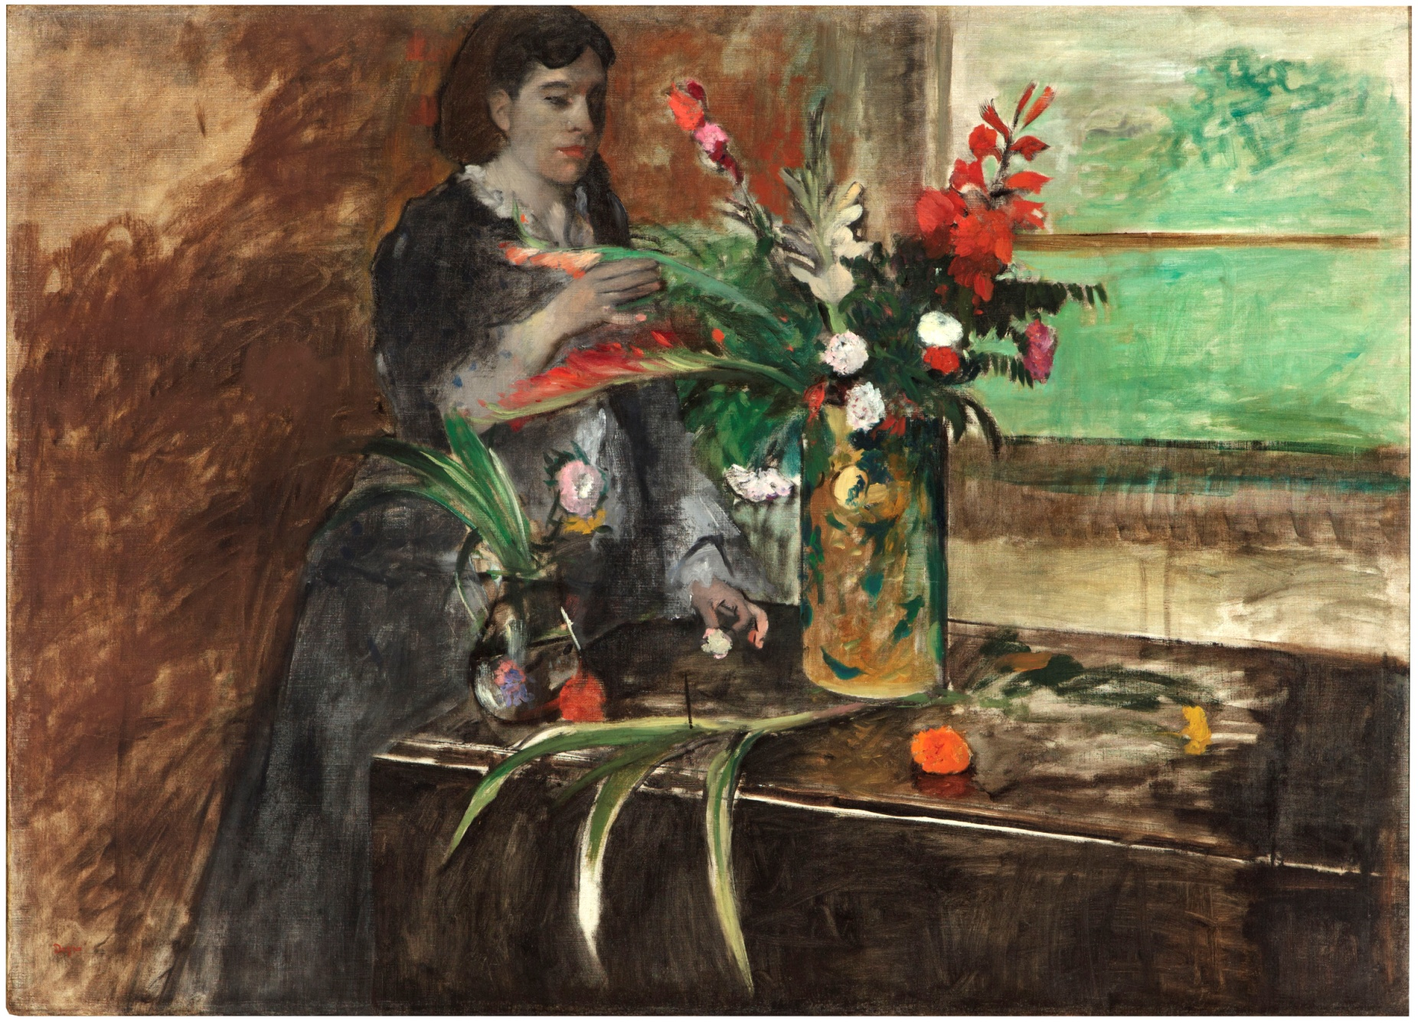

Slide 20
Introduction
Introduce yourself and welcome the group to NOMA
Briefly explain your theme and give the approximate length
Remind group of museum manners (if applicable)

Slide 21
Conclusion
Restate theme and summarize
Encourage group to spend time in galleries or return
Thank group for participating and leave them with information about events, membership, sculpture garden, etc.

